Slide 1


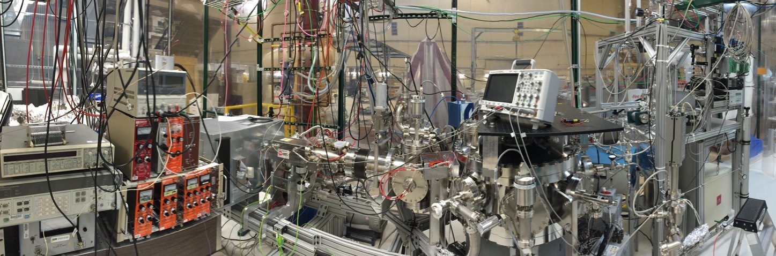
Ba Tagging from gXe
Group Meeting
June 5, 2015

Slide 2
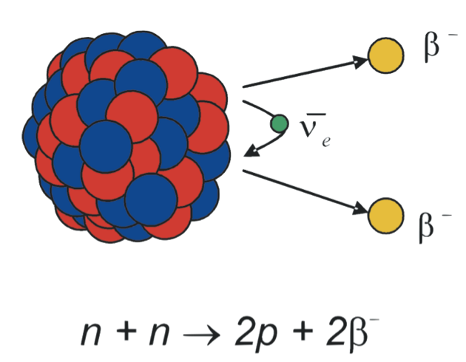
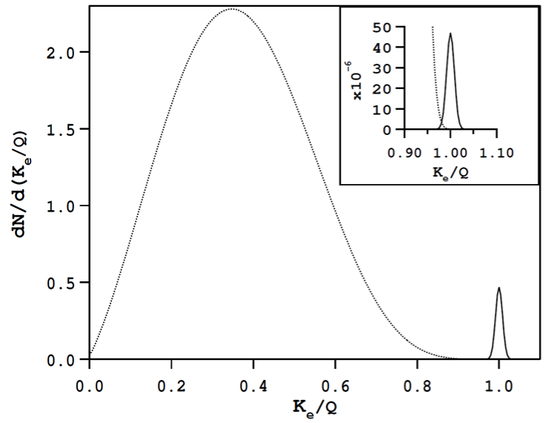
Double Beta Decay
0νββ peak
(normalized to 10⁻⁶)
[arXiv:hep-ph/0611243]
0νββ peak
(normalized to 10⁻²)
2νββ spectrum
Ba
Natural radiation decay rates
a banana ~10 decays/s
a bicycle tire ~0.3 decays/s
1 l outdoor air ~1 decay/min
100 kg of ¹³⁶Xe (2ν) ~1 decay/10 min
Time Scales
age of universe 1.4 x 10¹⁰ years
2vBB decay of 136Xe 2 x 10²¹ years
0vBB decay of 136Xe >10²⁵ years

Slide 3
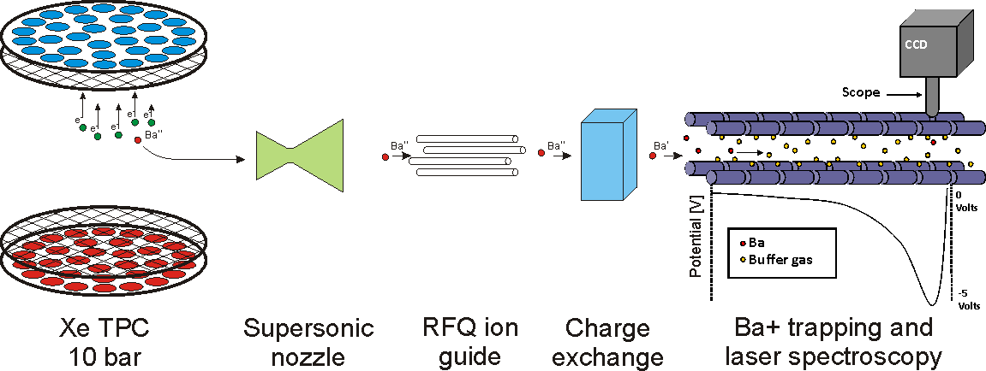
Barium Tagging
Idea: background free measurement to increase sensitivity to slower decay rates
  measure decay event positions and energies
  recover the barium ion
  tag event-recovery coincidences as ββ decay
  reject non-tagged events
How can one isolate a single barium ion from a sea of 10²⁸ xenon atoms?
Stanford’s prototype
Ba
Goal: 10⁻⁶ mbar

Slide 4
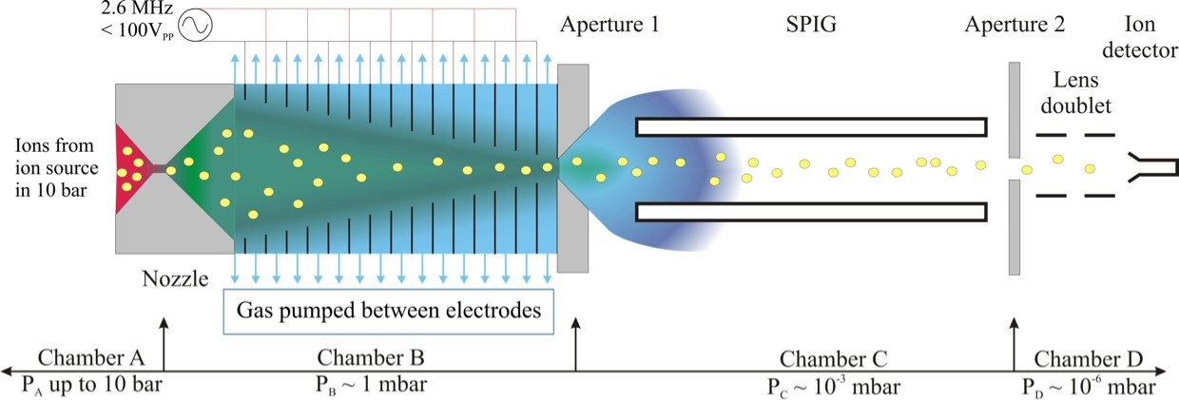
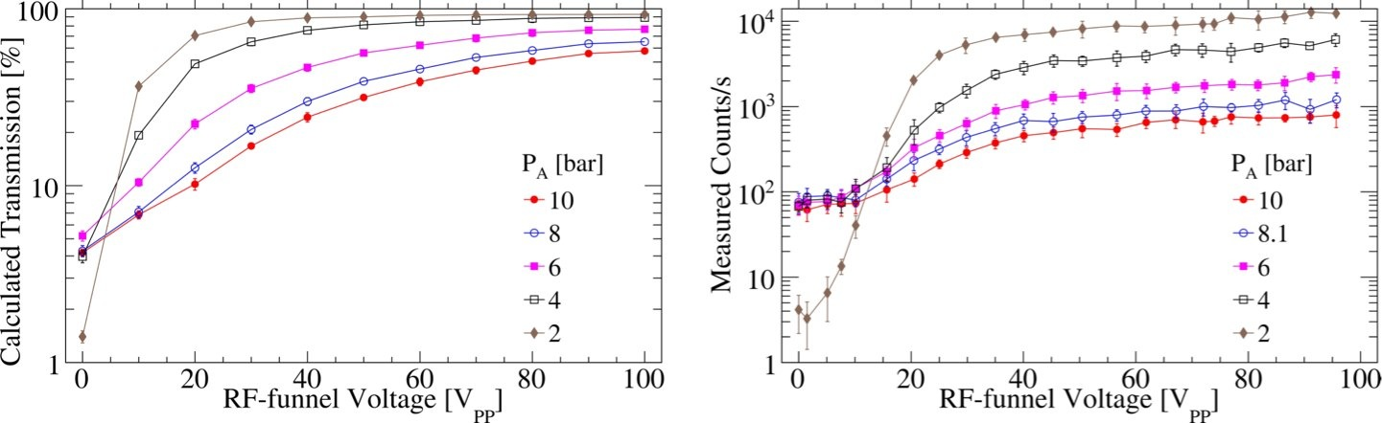
Extraction from high pressure gas xenon
Ba
Int. J. Mass. Spectrom. (2015) doi:10.1016/j.ijms.2015.01.003
Notes:
178.5 m^3

Slide 5
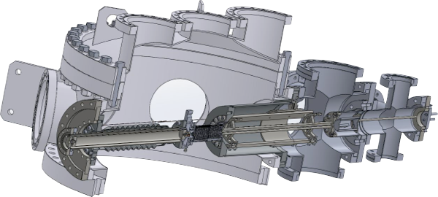
Cross Section with Subsystems
RF-funnel
supersonic nozzle
sextupole ion guide
aperture
ion detector
Ba source
Chamber A
2.4E-6 mbar
10 bar
Chamber D
Chamber C
Xe gas
~1 mbar
Or Ar gas
1.2E-3 mbar
Chamber B
TMP
80 l/s
cryo pump
8E-3 mbar
TMP
800 l/s
Xe high pressure
chamber
Xe gas
Differential Pumping Stages
Chamber A | Funnel Interior | Chamber B | Chamber C | Chamber D
High pressure Xe gas | Funnel | Cryopump chamber | SPIG chamber | Detection chamber
10 bar | ~1 mbar | 8E-3 mbar | 1E-3 mbar | 2E-6 mbar
See Winter 2013 EXO week talk for subsystem descriptions

Slide 6
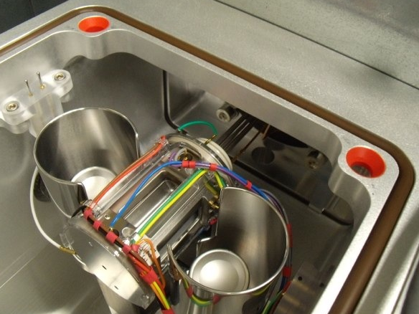
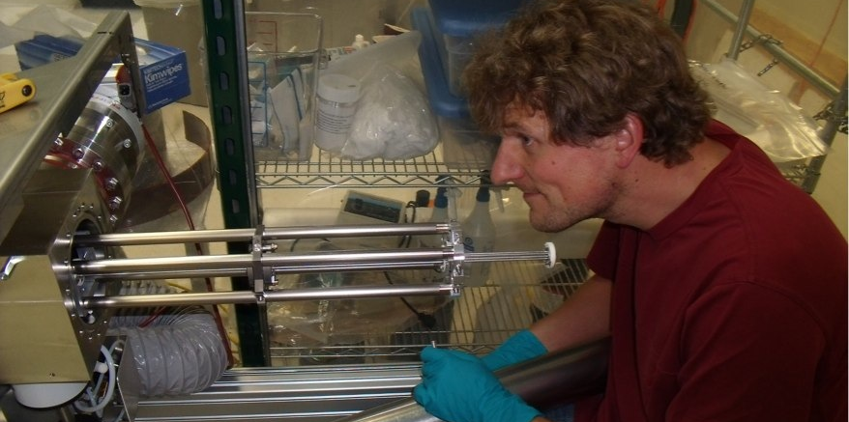
Thermo Finnigan LTQ
LTQ with octupole guide on loan from TRIUMF
couple to system for m/q identification
cleaned roughing vacuum sections
split system apart to test components and get everything working again
LTQ
Octupole
Fourier transform ion cyclotron resonance

Slide 7
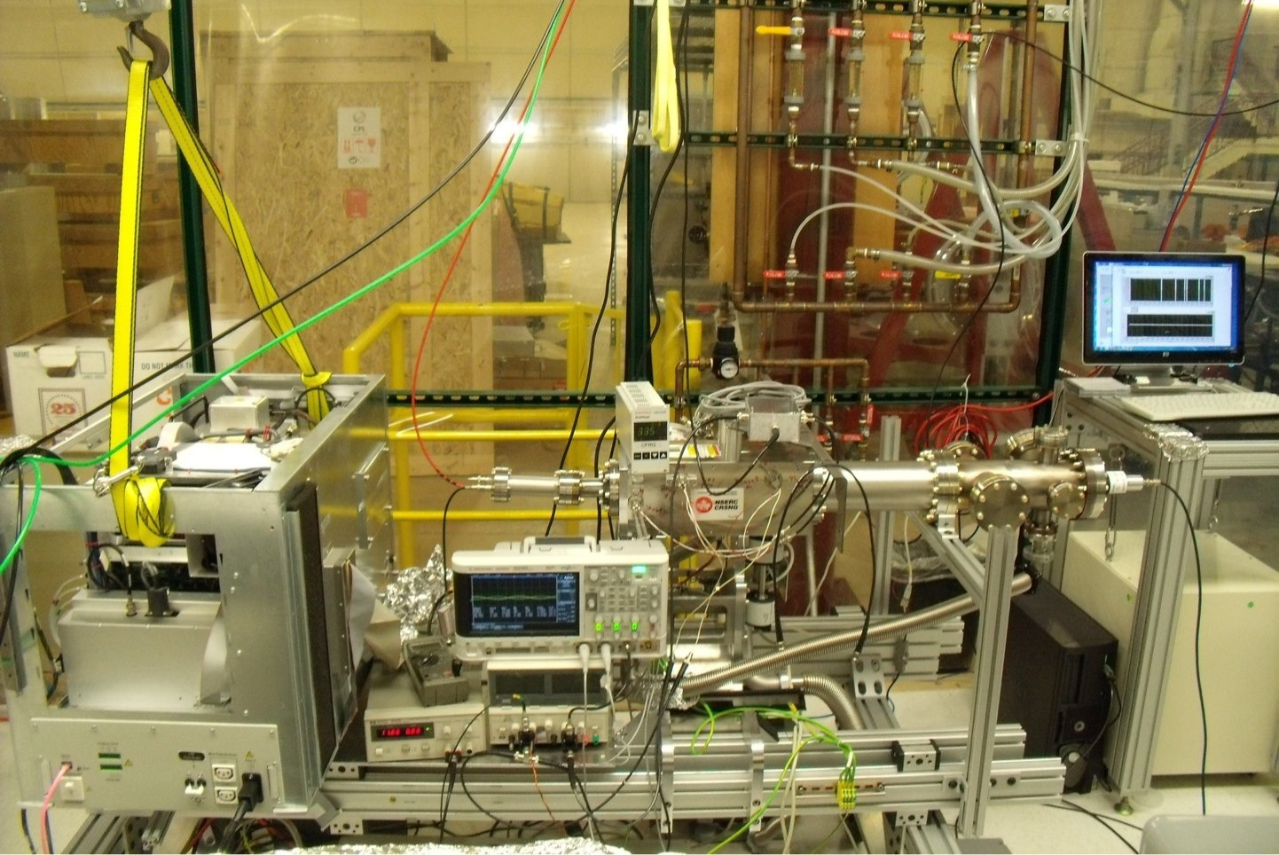
LTQ split for testing
Ion Source
Filament
LTQ
CEM
3 Octupoles
Apertures
Sliding rails

Slide 8
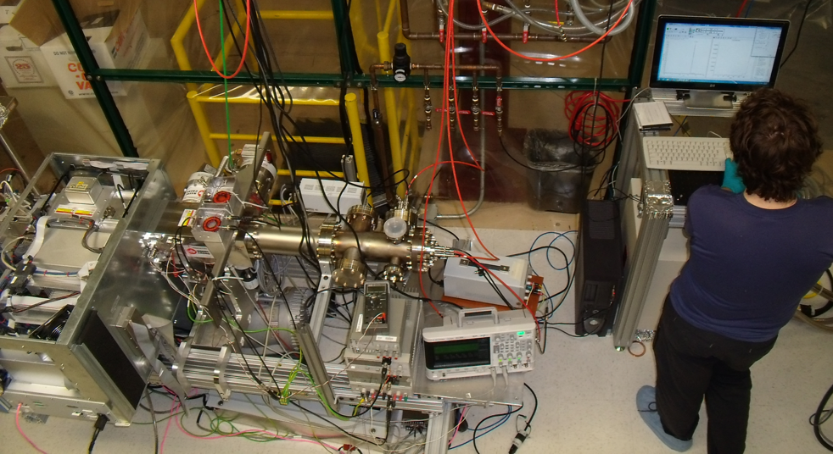
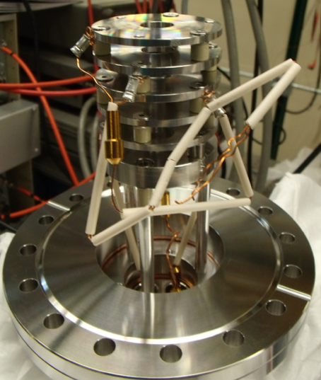
Recombined
after checking octupole transmission with CEM
reattached to LTQ
for tests with reversed injection use a blocked capillary to decrease gas load
successful tests of reversed system operation using cesium source at end of octupole

Slide 9
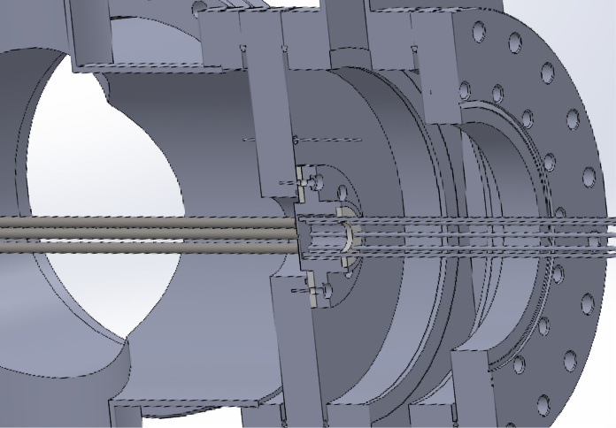
Connection of LTQ to system
need to close off LTQ from system for xenon recovery:
use manual gate valve with bellows & on tracks
new aperture aligns octupole
minimize insertion distance of octupole with
longer SPIG

Slide 10
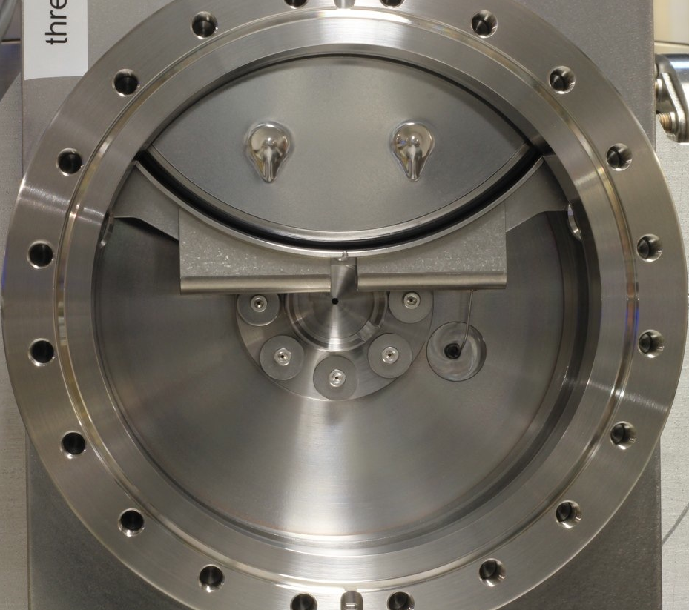
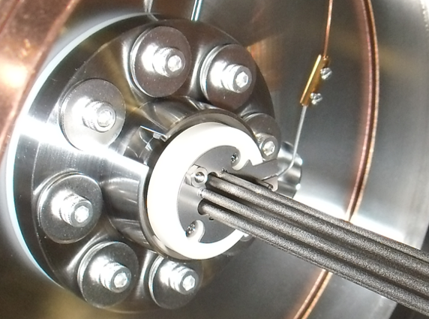
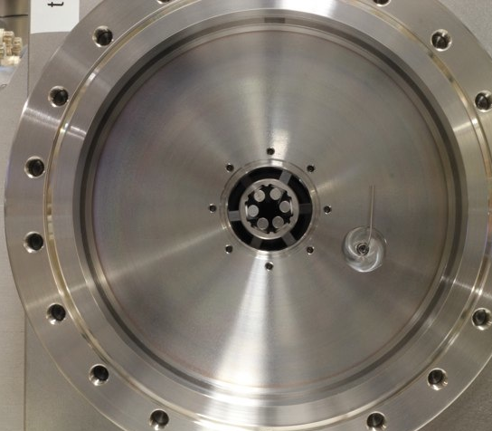
A Gate to another multipole

Slide 11
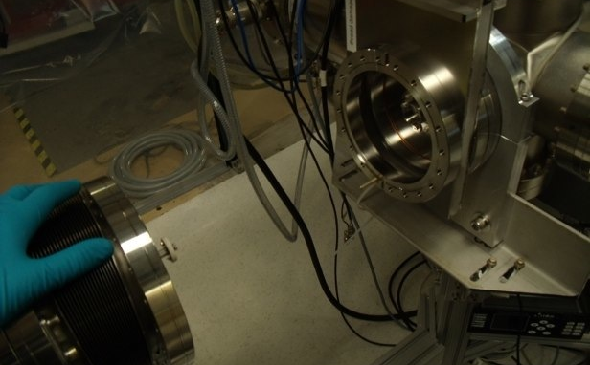
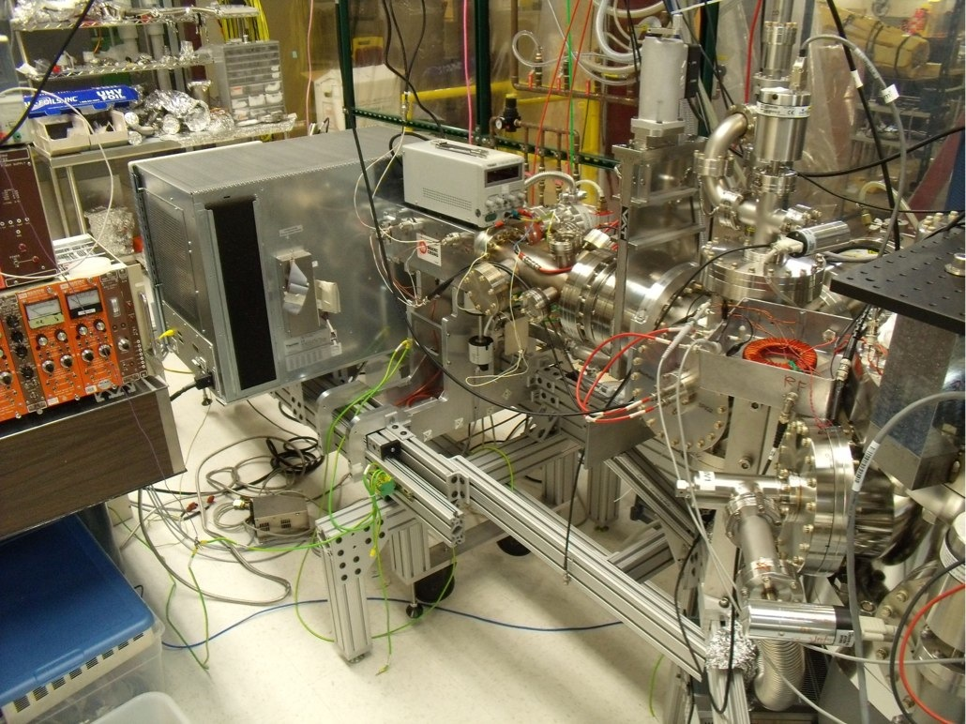
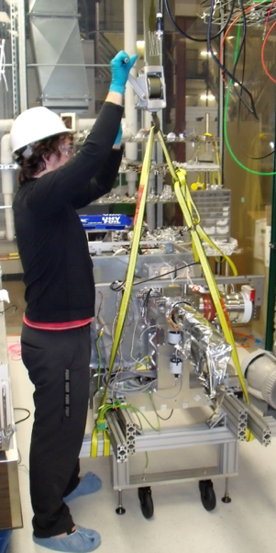
Installed in system
aligned
tested clearances
pumped everything down

Slide 12
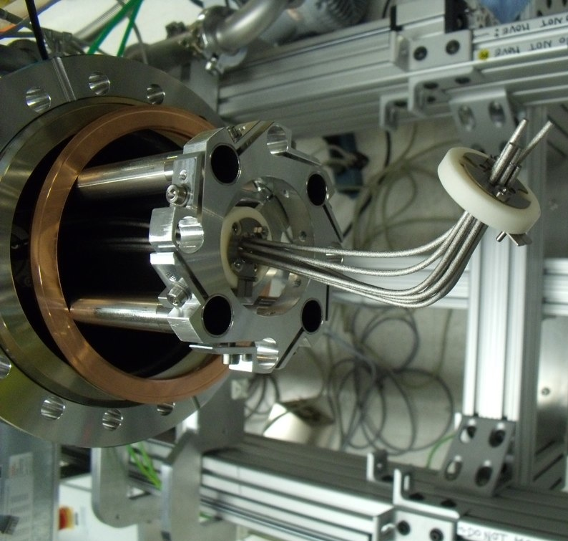
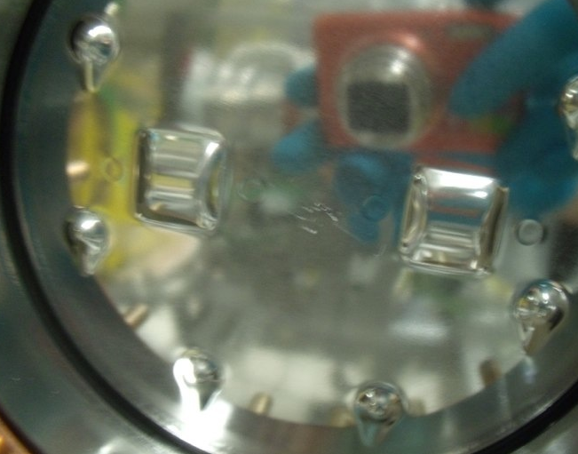
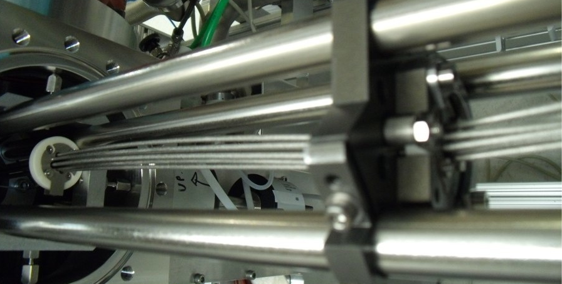
A Curve
Don’t Rush

Slide 13
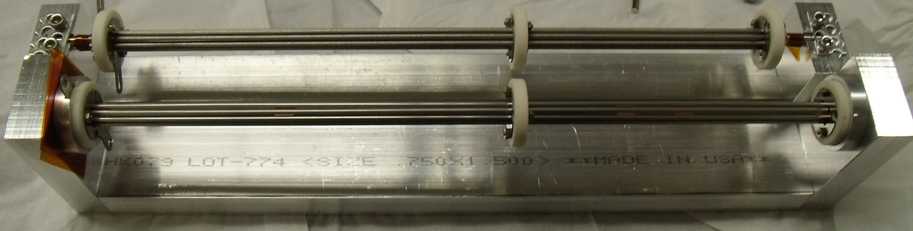
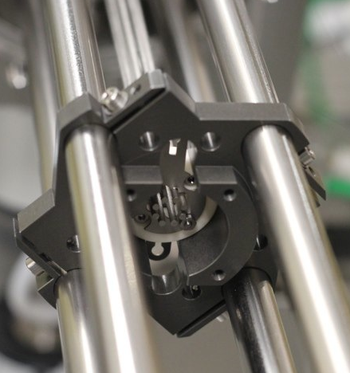
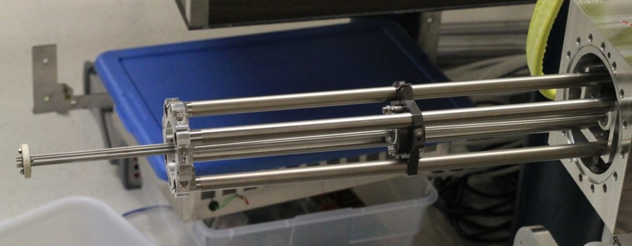
A Trip to Applied Fusion
1 new replacement octupole
fix 1 loose rod on back octupole
reinstalled

Slide 14
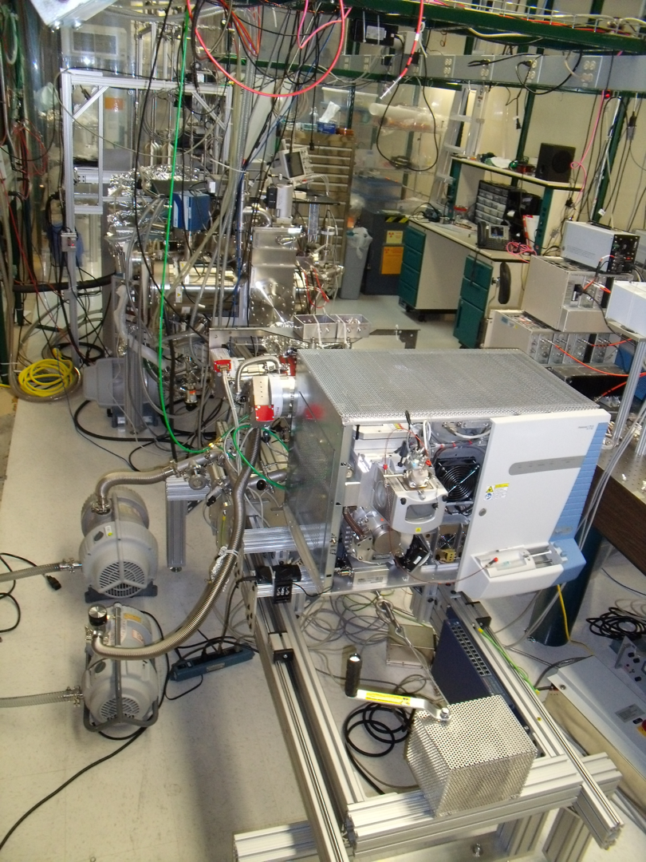
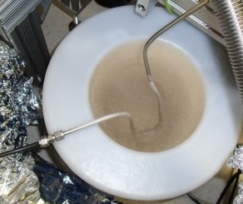
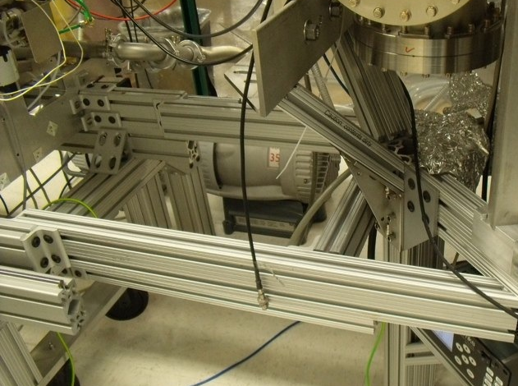
Improvements
winch
frame connection
laminated procedure
LN2 trap on He line
LTQ top

Slide 15
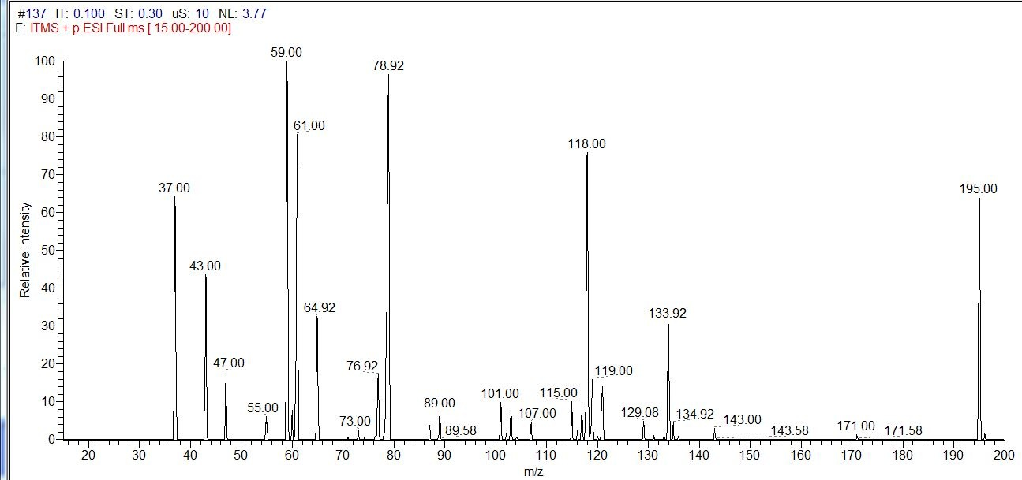
Caffeine & Isopropanol
using syringe pump to feed electro-spray ionizer
operating in LTQ normal mode: reverse from funnel mode
caffeine is lowest mass component of standard calibration mix
IPA-H+
Caffeine-H+

Slide 16
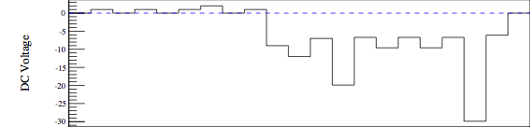

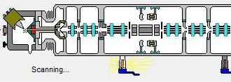

LTQ voltages for injecting from funnel
Inject constantly into the trap (TB,TC,TF) from the back
scans are at a rate of scan time + injection time
injection time controls G
TC
SPIG
TF
TB
Octupole
FL
G
AP
OAP2
OAP1
TC
BL
TF
TB
Octupole
AP
Funnel
SPIG
FL
G
Gate Lens
BL
OAP2
OAP1

Slide 17
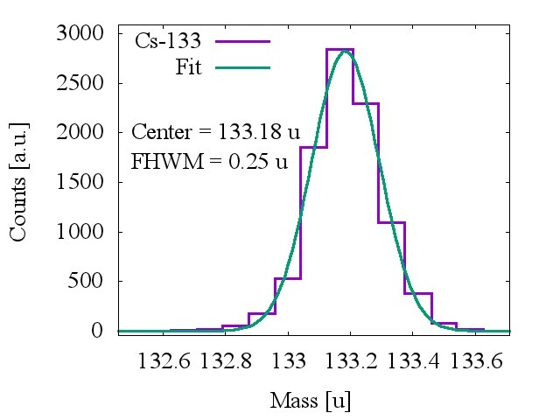
Cesium Injection
fit the spectrum seen with Cesium
only stable mass 133u
0.25 u resolution in mass range of interest
injects from same side as funnel
no mass shift in reverse operations
floated source to
simulate lower energy
ions from SPIG and
observed ions

Slide 18
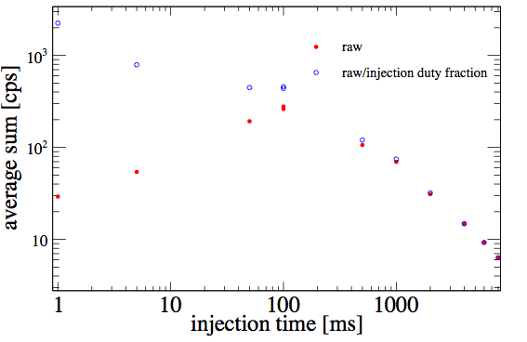
On Injection Time
~the time that the ions collide in trap before being measured
20150403 Argon
measurement time
~60 ms

Slide 19
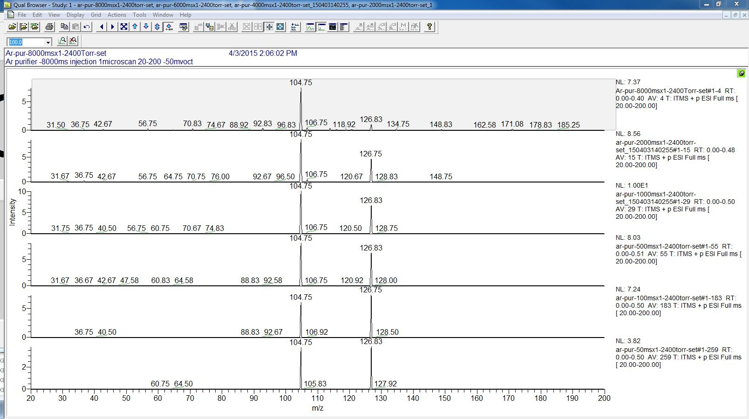
3 bar argon with purifier
looking at the mass peaks that make up these scans
105u
127u
8000 ms
2000 ms
1000 ms
500 ms
100 ms
50 ms
m/z

Slide 20
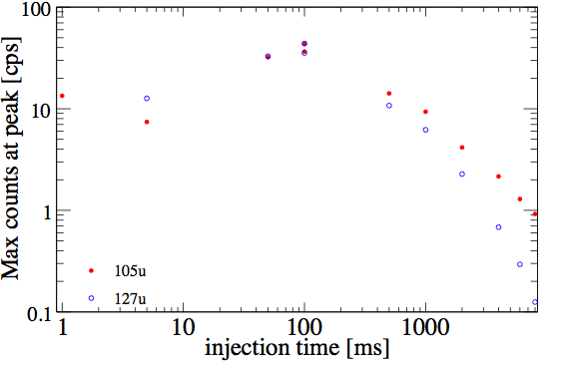
3 bar argon with purifier
comparing the two main peaks

Slide 21
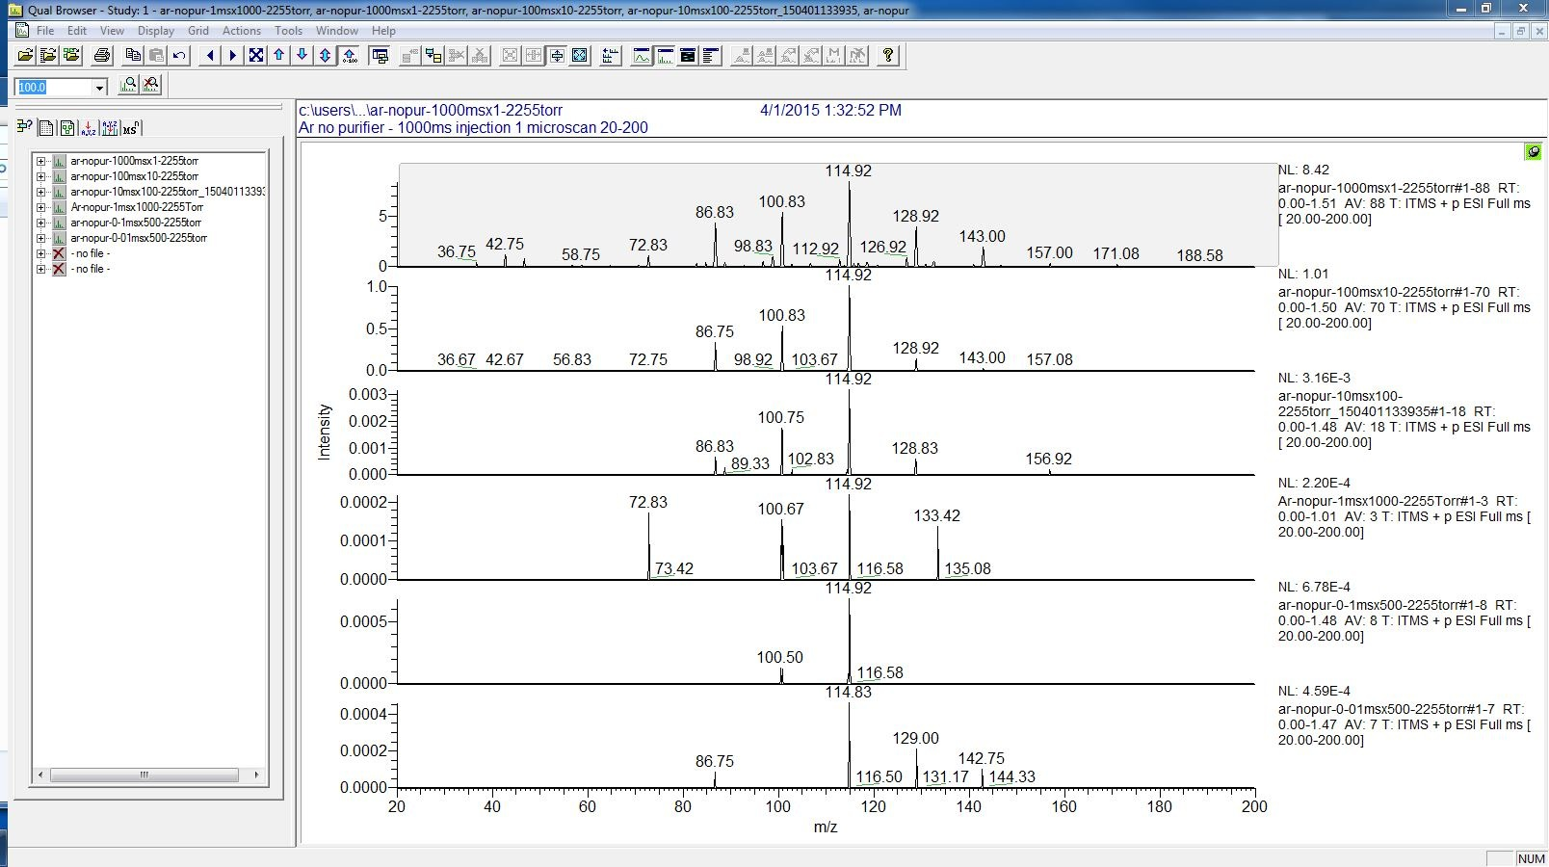
3 bar argon without purifier
long injection times (top): picket fence of peaks
14 amu spacing = CH2 ? sign of hydrocarbons
1000 ms
100 ms
10 ms
20
115u
m/z
200

Slide 22
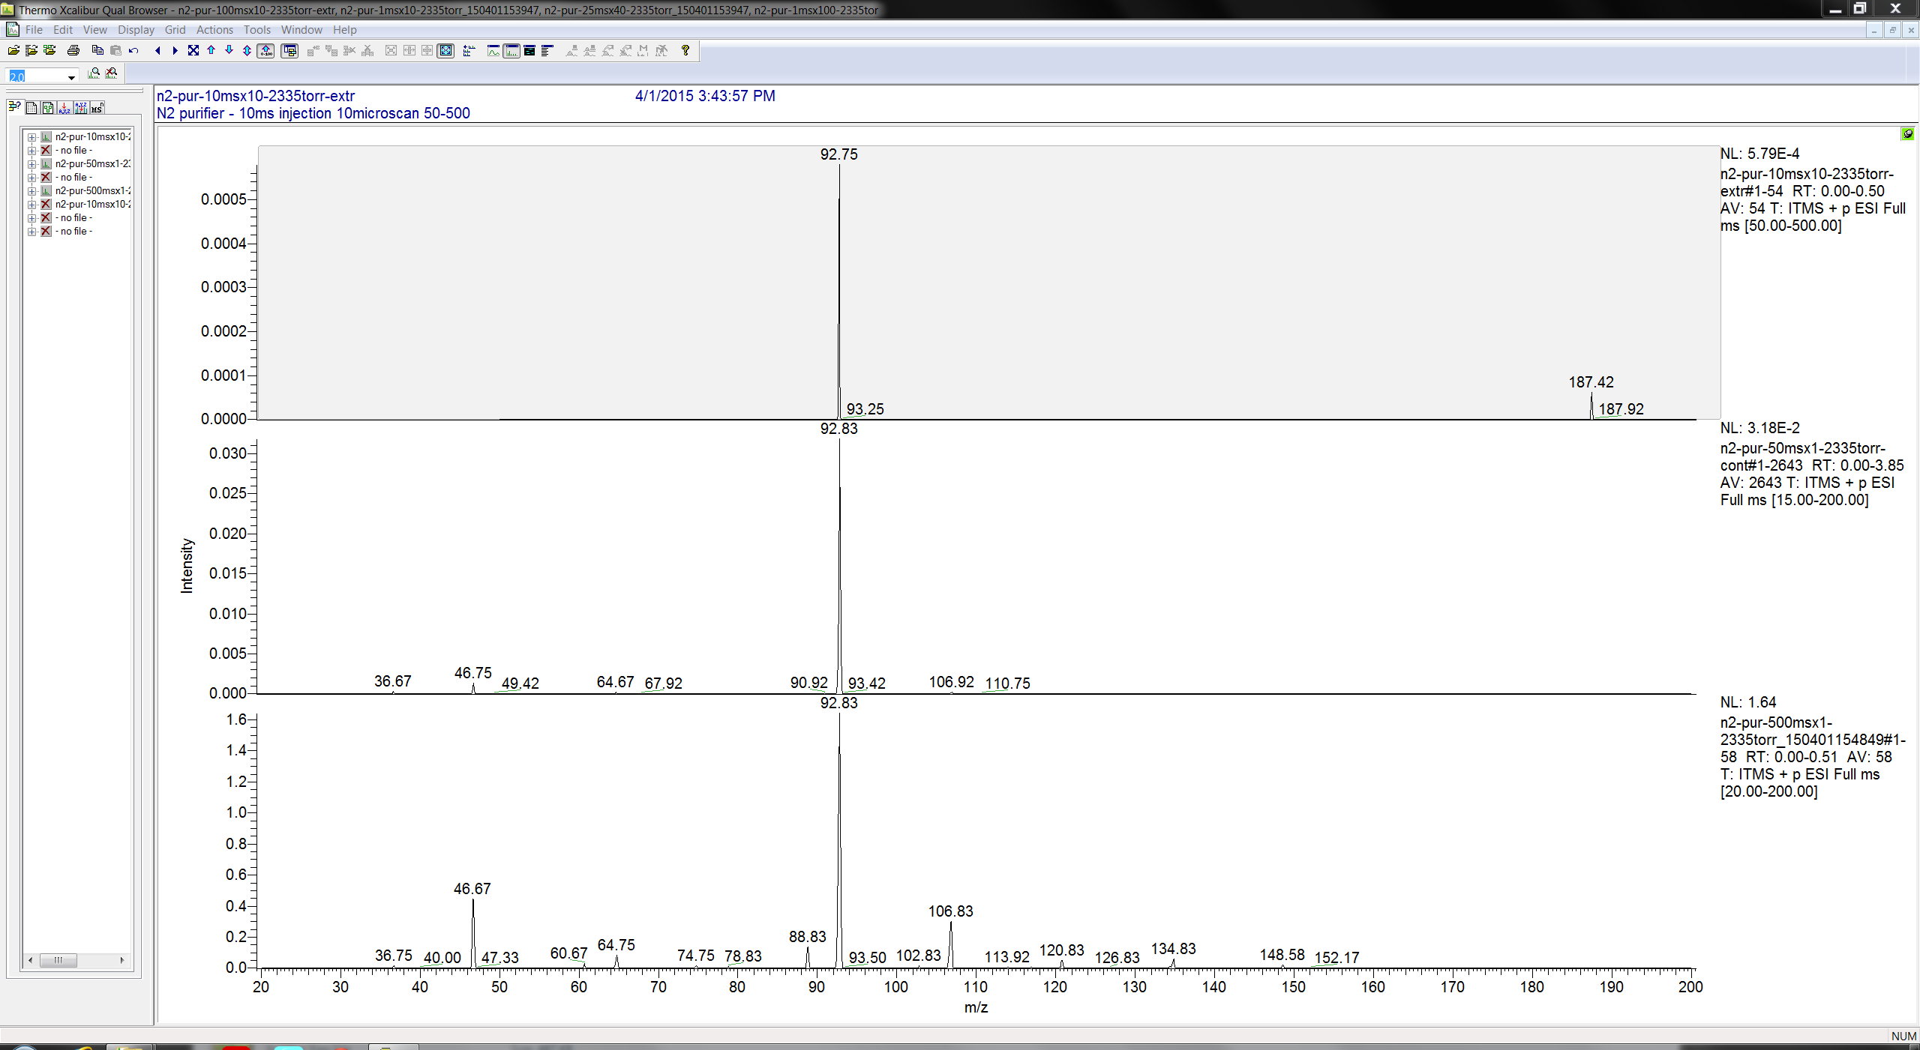
N2 with purifier
peaks differ from argon with purifier
still 14 amu spaced peaks at longer injection times
10 ms
no data below 50 on this scan
50 ms
500 ms
m/z

Slide 23
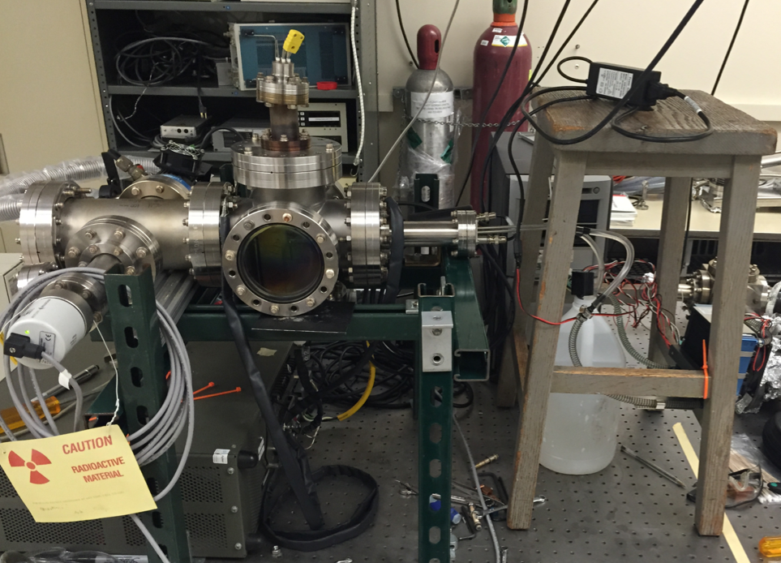
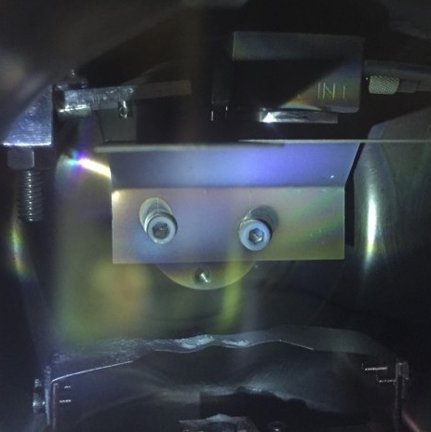
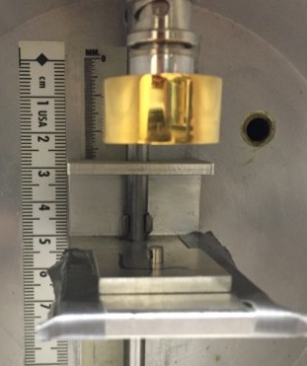
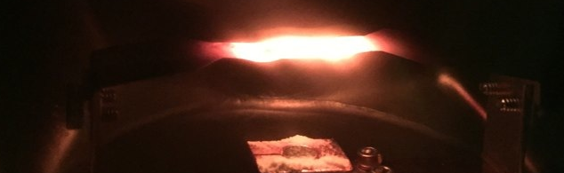
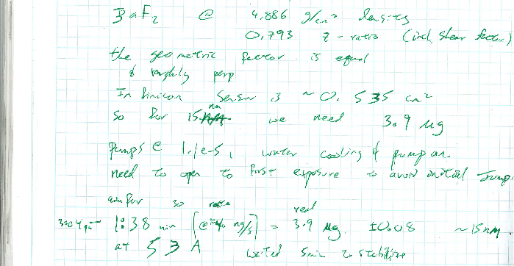
A New Source
no Ba/BaF/BaF2 was observed with the old source
rotational symmetry
adjustable distance
to nozzle
266Bq
(48 ul Gd)
15 nm BaF2
(3.9 ug @ sensor)

Slide 24
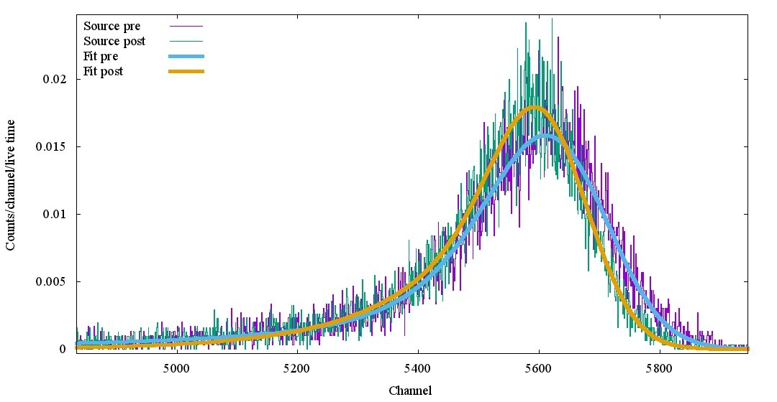
Pre and Post Spectrum
SRIM energy loss: 25.8eV/Angstrom of BaF2
alpha peak energy shift roughly consistent
fits estimate 50 - 120 nm BaF2 layer
electronics drift not compensated

Slide 25
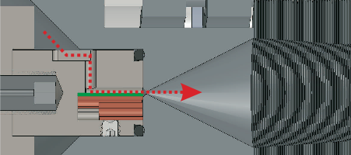
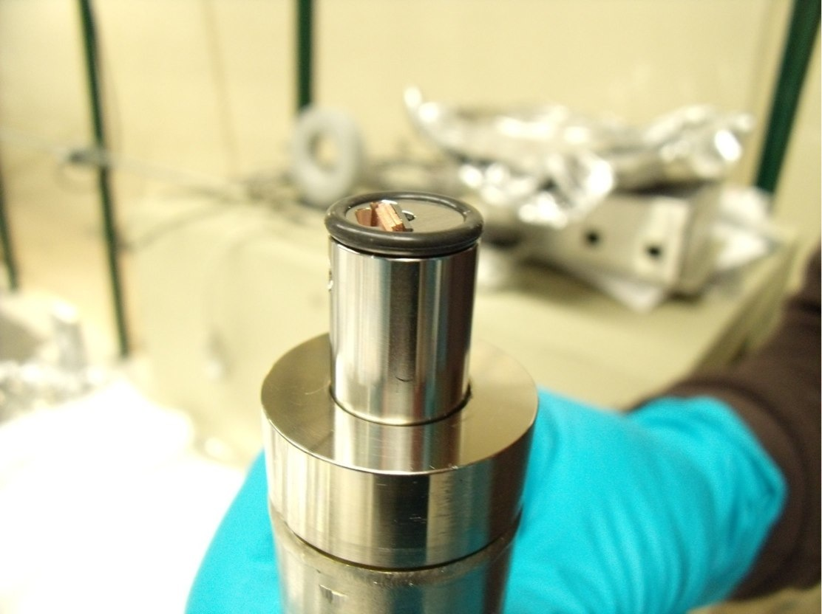
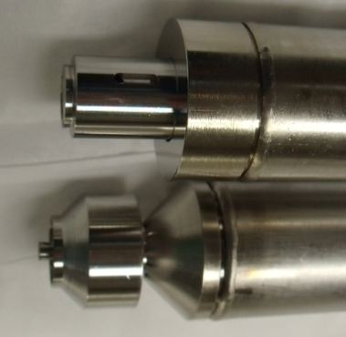
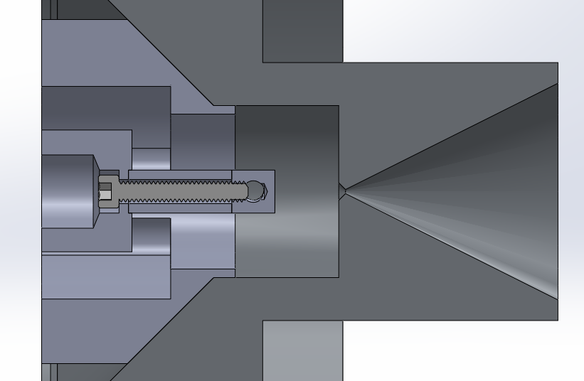
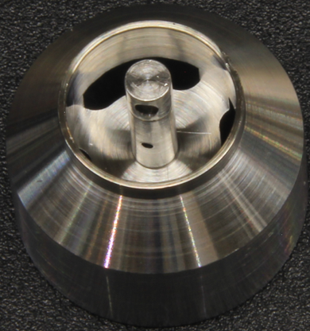
Source Holder Comparison
Xe gas
Gas
4.7mm
Gas
Source deposited on this face
Spacer to determine length

Slide 26
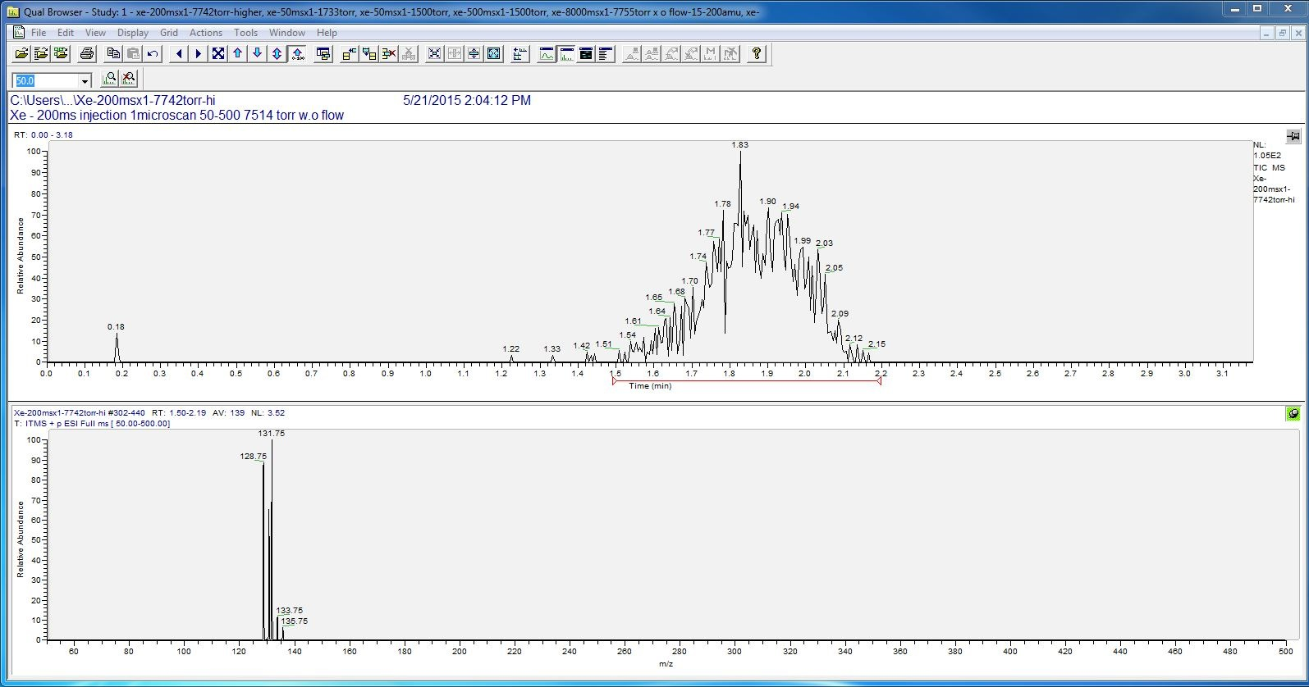
Xenon Runs
no counts observed at 10 bar
at lower pressures in chamber A : counts observed
reduced xenon pressure to 2 & 4 bar
AXES LABELS
gas open
gas closed

Slide 27
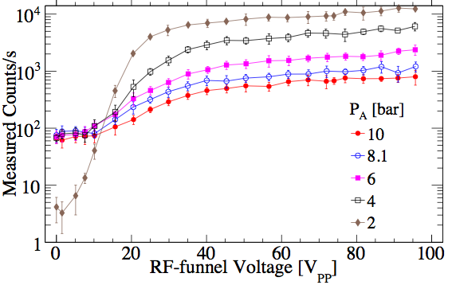
Recall CEM measurements
count dependence on pressure

Slide 28

Xe scans: 4 bar at 122-159u
composition of peaks changes with injection time
at times of over a second: many more peaks
20 ms
50 ms
100 ms
200 ms
600 ms
1000 ms
3000 ms
8000 ms
m/z
132u

Slide 29

Comparing to 132u
all peaks observed shown

Slide 30

RGA Xenon & Comparison
pre run puffed xenon in, while cryopumping
blue : each m/q fit to A exp(-B t ) + C at t=0
peaks centered -0.4 amu below integers
127
129
131
132
134
136
127 is not a Xe isotope
[amu]

Slide 31

Comparing to 132u
only looking at xenon isotope masses

Slide 32

Xenon injection at 4 bar
at long times pick something up at ~32 amu
methanol CH3OH ? charge exchange?
20 ms
?
60 ms
500 ms
m/z

Slide 33

Ar, N2, Xe at 500 ms
3 bar Ar
3 bar N2
4 bar Xe
m/z

Slide 34

Ar
N2
Xe
Zoomed
Ar
N2
Xe

Slide 35

Ar, N2, Xe at 200 ms
Suspect Ar run need to check if all 5.4 bar that way.
Ar
N2
Xe
m/z

Slide 36

Ar
N2
Xe
Zoomed
Ar
N2
Xe

Slide 37

Next Steps
release the data from being tied to the ThermoFinnagin format to get timing information so that can scan against other voltages
separate LTQ from octupole, connect CEM to octupole, measure transmission curves
  reproduce old curves with new source
potentially polonium source for higher intensity
learn chemistry to guess peaks
investigate effectiveness of cold trap for helium line
ν

Slide 38
Backup slides

Slide 39

Initial Running
Observed Ion counts from source
Qualitative agreement with simulations
Creation of ion species other than Ba⁺⁽⁺⁾
See Winter 2013 EXO week talk for more on initial run

Slide 40


Increasing Stability
Covered ceramics more aggressively
Installed additional set of baffles inside to reduce temperature change of the funnel
Took short runs at identical conditions between longer runs for argon
New Baffles
Cryopump 1st Stage

Slide 41


Qualitative agreement of gas flow
in xenon (left)
  462 l/s pumping speed
  scan of PA
and argon (bottom)
  534 l/s pumping speed
  below 1.5 mbar
  scan of PB

Slide 42

Qualitative agreement in count rate
Calculation
Measurement
for selected xenon pressures in chamber A
there is pressure dependence of the source production rate

Slide 43


Qualitative agreement in count rate
Calculation
Measurement
5.4 bar argon pressure in chamber A shown
scanning properties at higher pressure in B

Slide 44
Calculated

Slide 45
Measured

Slide 46
System Stuff
RF-funnel
supersonic nozzle
sextupole ion guide
aperture
ion detector
Ba source
2.4E-6 mbar
10 bar
Xe gas
~1 mbar
1.2E-3 mbar
TMP
80 l/s
cryo pump
8E-3 mbar
TMP
800 l/s
Xe high pressure
chamber
Xe gas

Slide 47

Diagram Main

Slide 48

LTQ Diagram

Slide 49


Ba-ion source
¹⁴⁸Gd driven Ba⁺ source (Rev. Sci. Inst. 81 113301 (2010))
¹⁴⁸Gd activity before BaF coating ~144 Bq
Calculated Ba⁺ rate of ~59Hz
Simulation of α energy loss in xenon and argon through ionization
Mean energy for electron-ion pair production W=21.7eV (xenon) and W=25.8eV (argon) used to estimate ion production
Xe gas

Slide 50





RF-funnel Assembly
28 mm
336 (301 + spares) photo-etched electrodes by Newcut
6x7 electrodes/sheet @ 8 sheets
Metal sheet: 0.1016 mm (±0.00254 mm)

Slide 51




The SPIG
26

Slide 52



Funnel Parameters
Converging-diverging nozzle
Half-angle of subsonic cone 45º
Half-angle of supersonic cone 26.6º
Throat diameter 0.28 mm
Mass Flow 0.33 g/s
Exit diameter 16.0 mm
Subsonic part length 0.5 mm
Supersonic part length 15.5 mm
RF-funnel electrodes
Entrance aperture diameter 16.0 mm
Exit aperture diameter 1.0 mm
Ring electrode diameter 28 mm
Change in aperture diam./el. 0.05mm
Ring electrode thickness 0.1 mm
(design) +/- 2.54 μm
Gap between electrodes 0.25 mm
Total number of electrodes 301
CU
0.6299”
0.0394”
1.1024”
0.0020”
0.0040”
0.0001”
0.0100”

Slide 53



Monte Carlo gas flow simulations
Gas flow pattern inside funnel depends on ambient pressure in chamber B (P_{B})
Upstream pressure changes gas flow rate through funnel & thus transmission efficiency
Simulated Ar in addition to Xe
Points of comparison to 10 bar Xe:
  5.4 bar Ar similar gas flow (mbar l/s)
  18 bar Ar similar Reynolds number at nozzle throat
P_{B}= 0.0035 mbar
Upstream pressure:
P_{A}= 5.4 bar
Argon Gas
P_{B}= 0.85 mbar
P_{B}= 13.3 mbar

Slide 54
Extra Plots

Slide 55

Mean free path of operation gasses

Slide 56
Gas load in the system
 | Chamber A | Chamber B | Chamber C | Chamber D
Gas op. pressure (Ar) [Torr] | 4027.8 | 0.00503 | 0.00210 | 9.6E-6
Gas op. pressure (Xe) [Torr] | 7500.7 | 0.00251 | 0.000988 | 7.1E-6
Pumping speed (Ar) [l/s] |  | 8300 | 800 | 66
Pumping speed (Xe) [l/s] |  |  | 457.1 | 38.3
Gas load (Ar) [gps] | ? 0.0379 | 0.0913 | 0.00367 | 1.38E-06
Gas load (Xe) [gps] | 0.0379 | ?0.102 | 0.00324 | 1.95E-06
Gas load (Ar) [gph] | ?136 | 329 | 13.2 | 0.00498
Gas load (Xe) [gph] | 136 | 367 | 11.7 | 0.00703
Italic: Guessed/extrapolated values
? Indicate rough guesses

