Slide 1
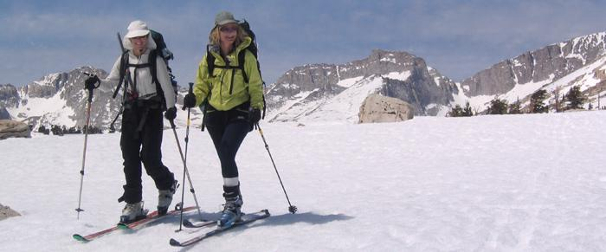
“Across California on Skis”

Slide 2
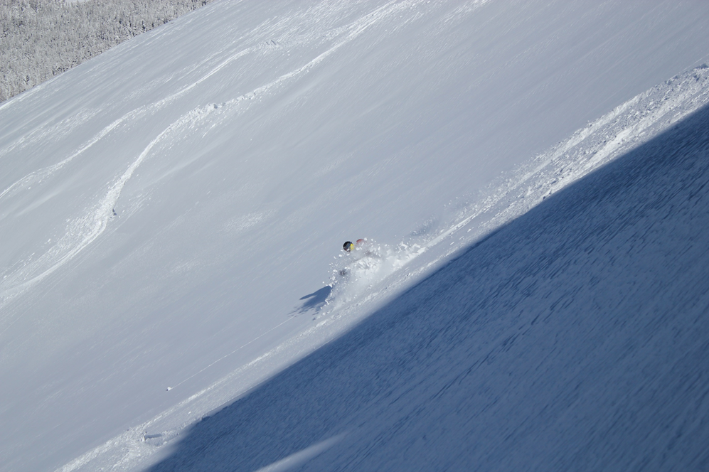
Introduction
Ski regions
When to ski
Where to stay
What to do: the traverses, peaks and tours
Where else to find information

Slide 3
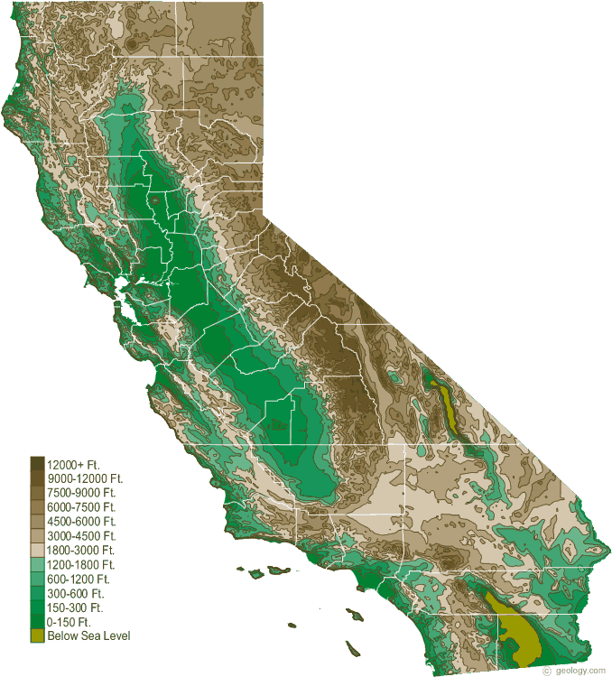
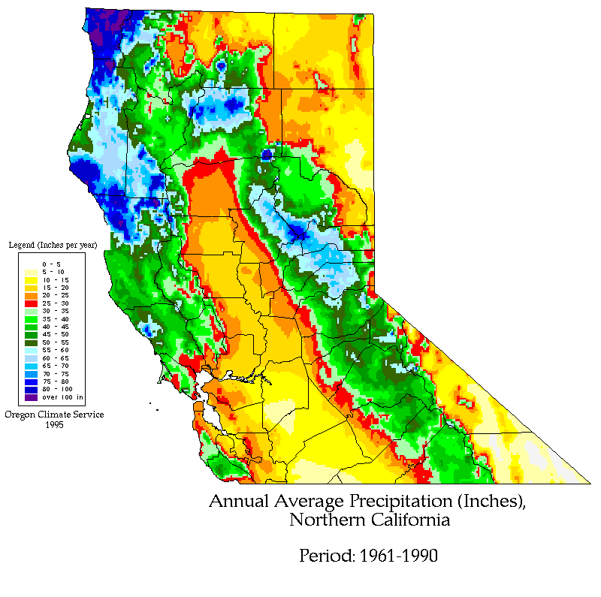
Places to go skiing in CA?
CA precipitation map
CA physical map

Slide 4
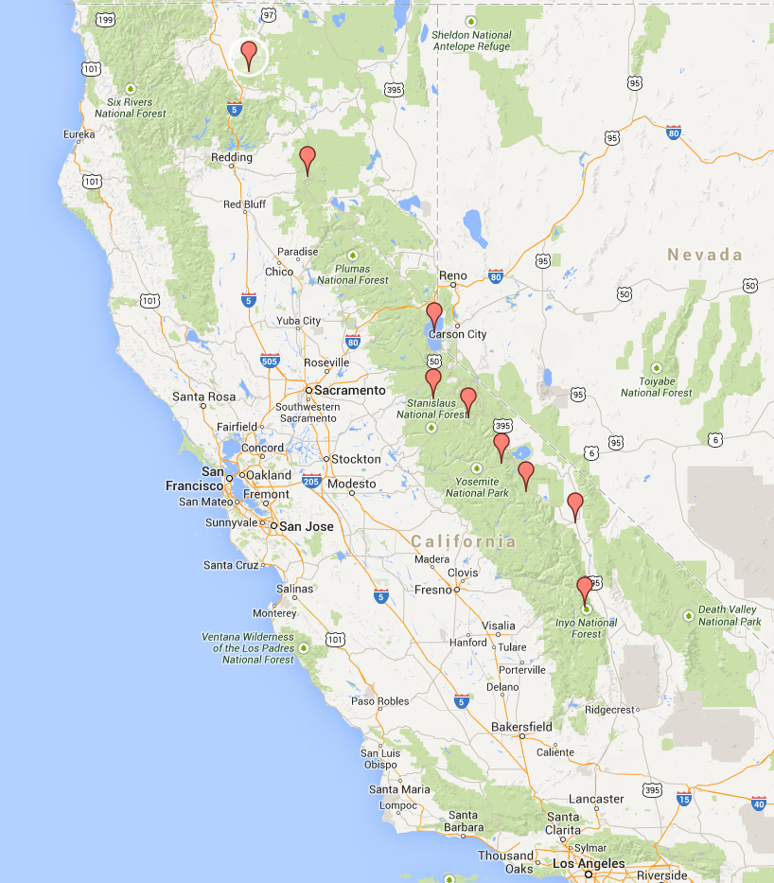
Ski regions
Shasta
The mountains in California span a significant distance nearly 800 miles in total length, and several major ranges. Because of this, we have chosen to break the presentation into sub regions of California.
From north to south they are:
- The volcanos - Shasta and Lassen
- Lake Tahoe - Tallac, Castle Peak, Mt Rose, Rubicon, Waterhouse, Carson Pass
- Sonora Pass
- Tioga Pass - Mt Dana, White Mountain
- The Eastern Sierra - Mammoth, the Sawtooths, Rock Creek, Bishop, the Palisades, Mt Whitney
Lassen
Lake Tahoe
Mammoth
Whitney

Slide 5
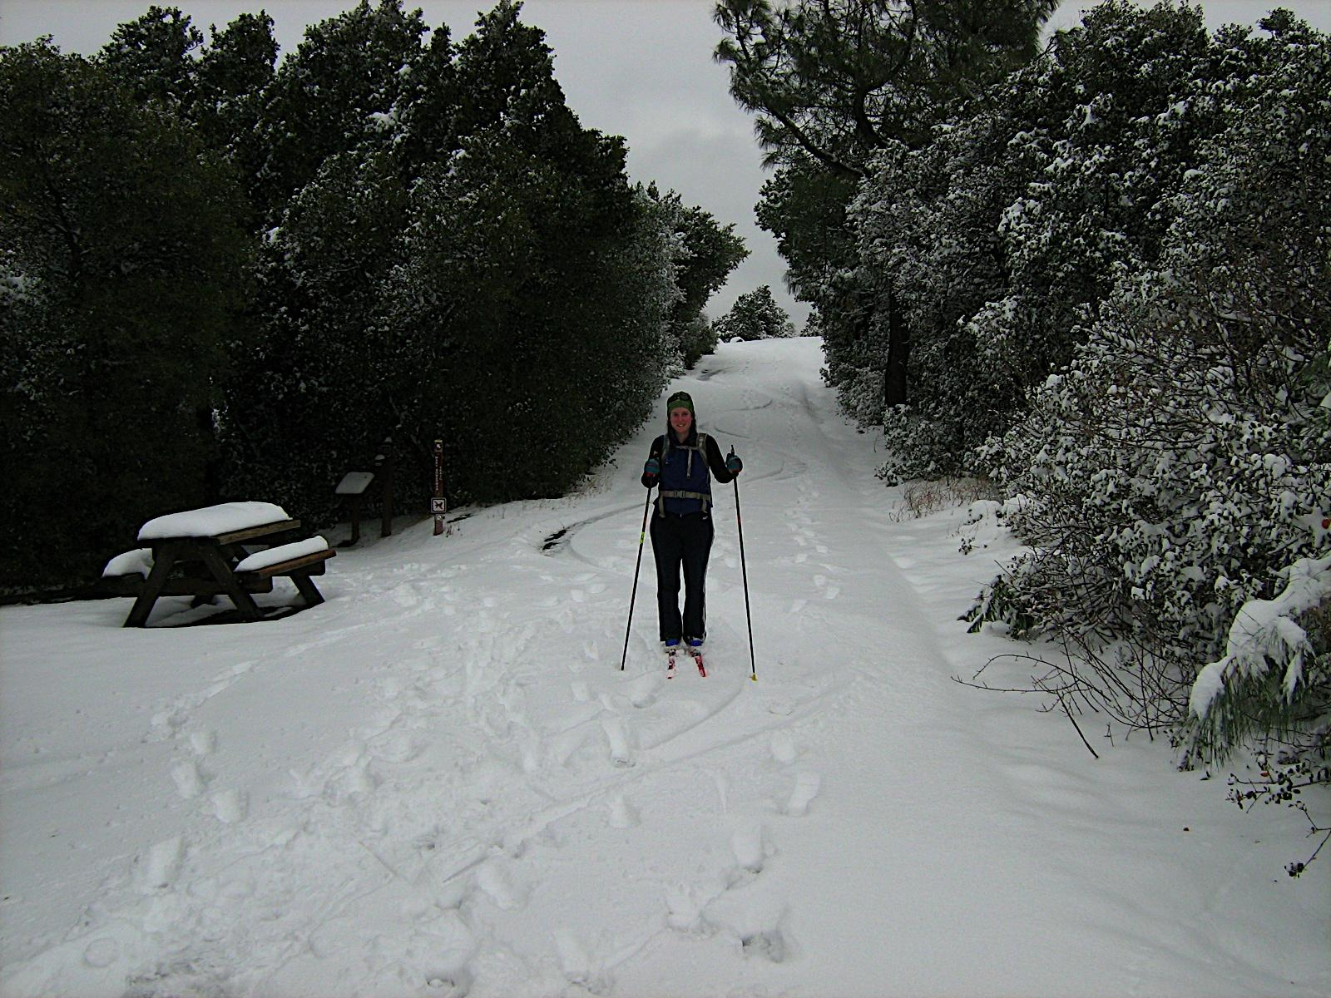
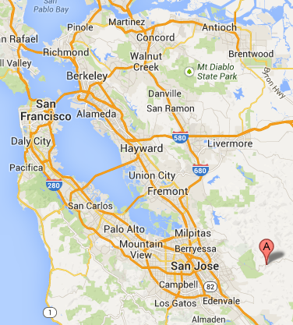
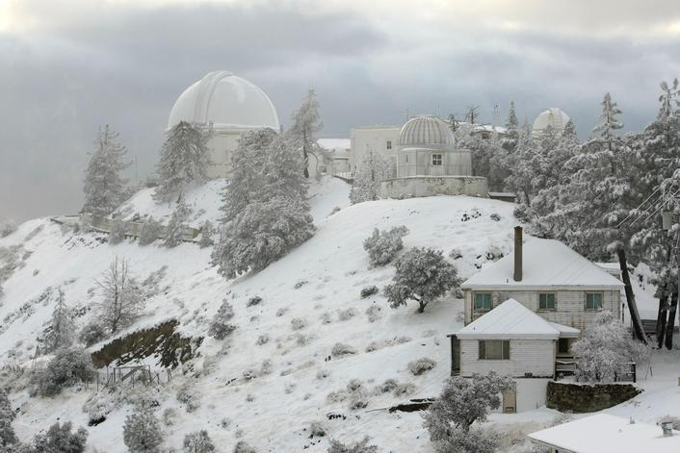
Or you get lucky in the Bay Area
Rachel skiing on Mt. Diabolo
Lick observatory
winter 2011
http://attitudeofgratitude.typepad.com/attitude_of_gratitude/2011/02/winter-wonderland.html

Slide 6
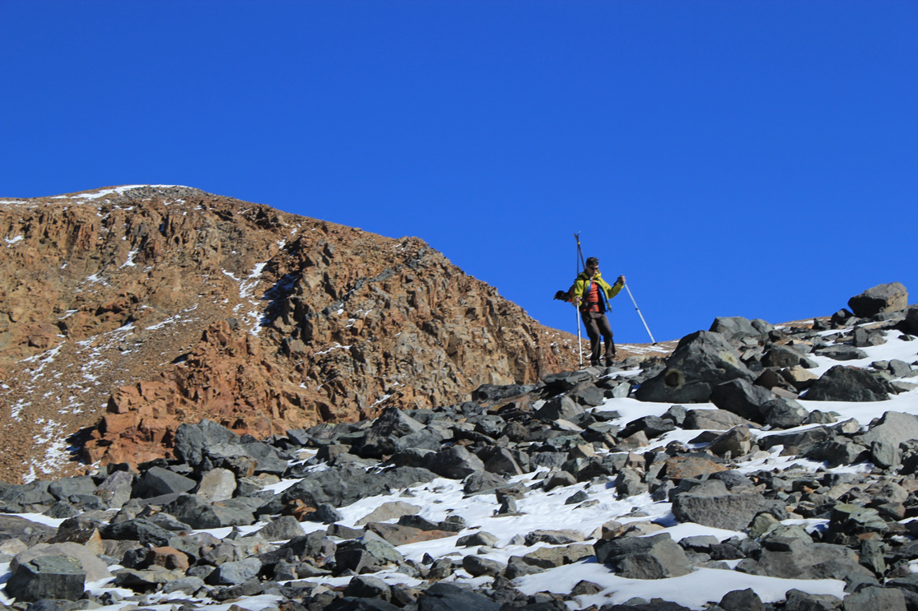
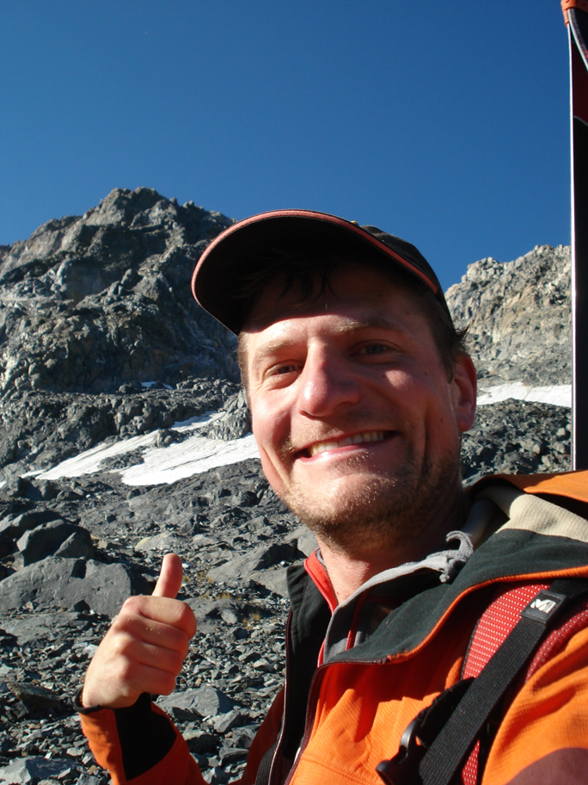
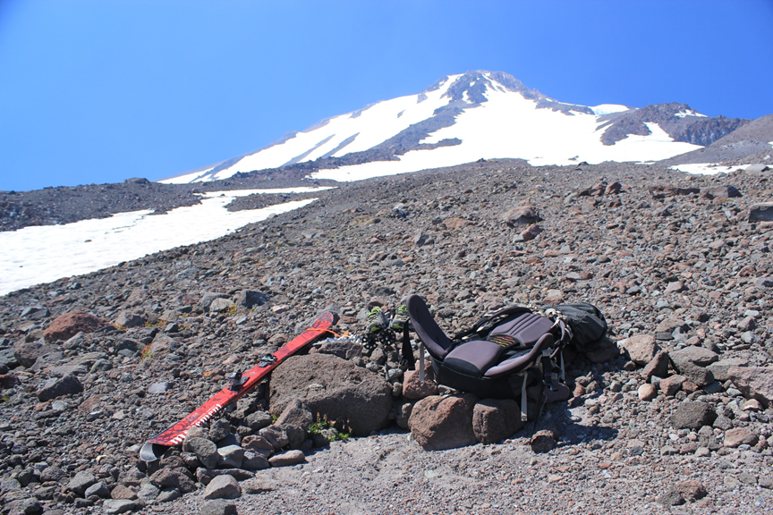
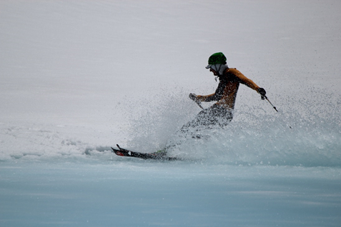
When to ski?
Year round, best December until June
Access to places limited due to winter road closure
Lassen Peak
Sonora pass
Tioga Pass
The above are best skied as soon as the road opens
Mt Dana
Nov. & Sept.
Shasta in August
Lassen end of May

Slide 7
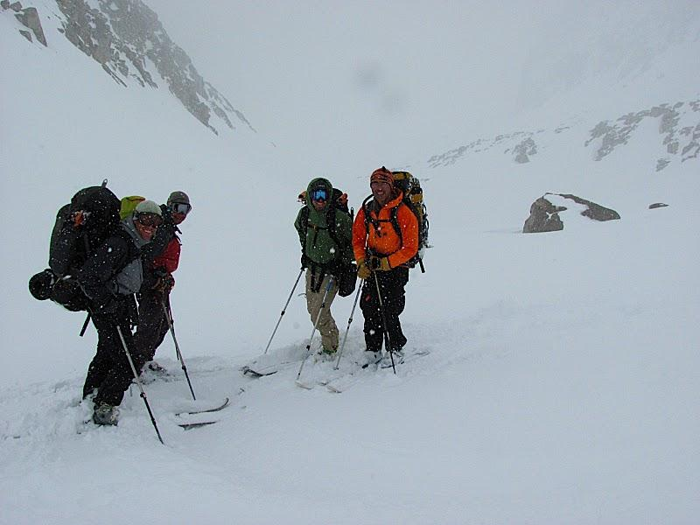
What to do?
-Traverses
- Peaks
- Tours

Slide 8
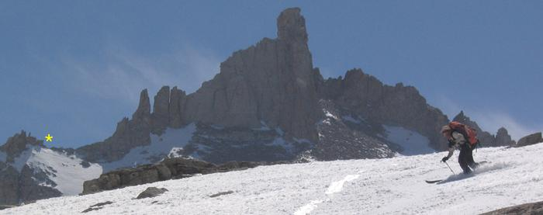
Traverses - The High Route
A trans-Sierra, the High Route is a 50 miles east to west or west to east, ski tour. Most skiers take 4-6 days to ski it, although it has been done in a day! Start/End - Sequoia National Park and Symmes Creek on the east side of the Sierra. It takes a high line, never dropping below 10,000 ft.
Descent of Milestone Pass, elevation 13,000 ft.

Slide 9
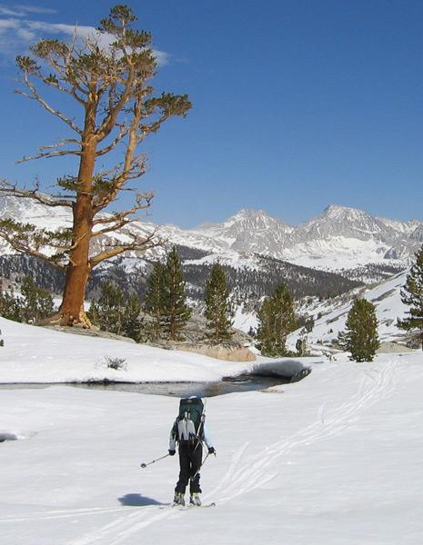
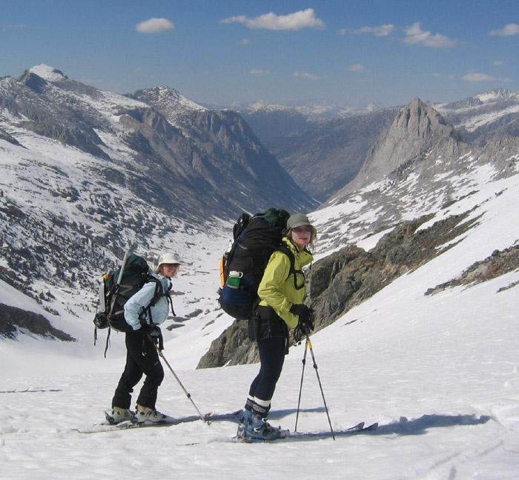
Traverses - Sierra High Route
Near Kern Canyon, Mt Whitney in the distance
Above Cloud Canyon, Kings Canyon

Slide 10
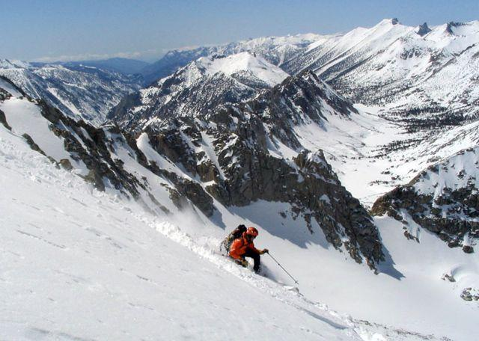
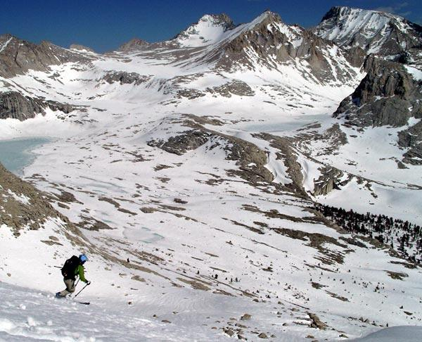
Peak descents - not for the faint of heart!
Barnard peak, 13,990 ft. Eastern Sierra
Kearsarge Peak, 12,598 ft - Eastern Sierra

Slide 11
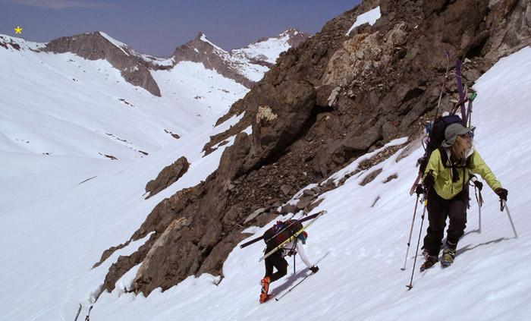
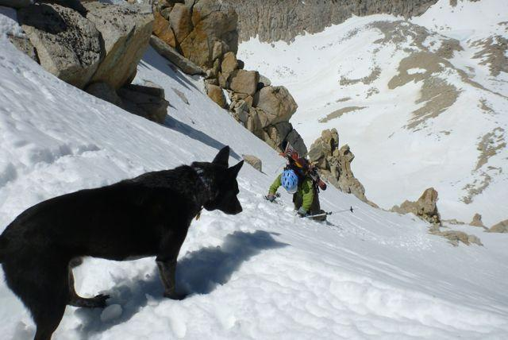
Peak descents need peak climbing!
Y couloir, el ~12,000 ft, Mt Conness,Tioga Pass
Triple Divide pass, el 12,160, Sierra High Route

Slide 12
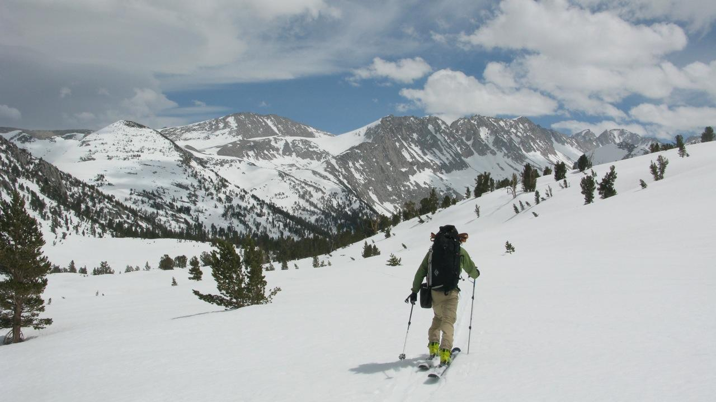
Ski tours - no crowds, no dirt, no trails, no problem
Mammoth backcountry

Slide 13
Where to stay (ski in)
Huts
Lake Tahoe: Sierra Club Huts - Peter Grubb, Benson, Bradley, Ludlow
Yosemite:Ostrander, Snow Creek
Sequoia:Pear Lake
Snow camping - anywhere there is snow!

Slide 14
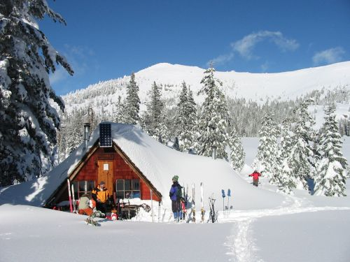
Sierra Club Huts - Peter Grubb

Slide 15
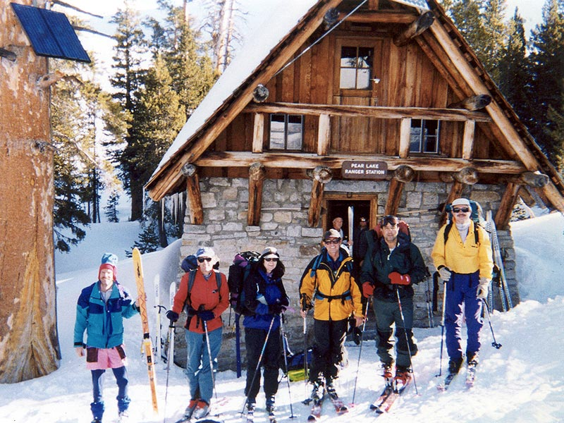
Sequoia National Park - Pear Lake Hut

Slide 16
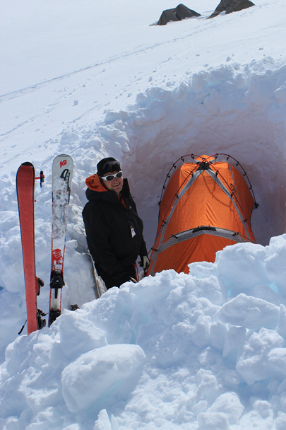
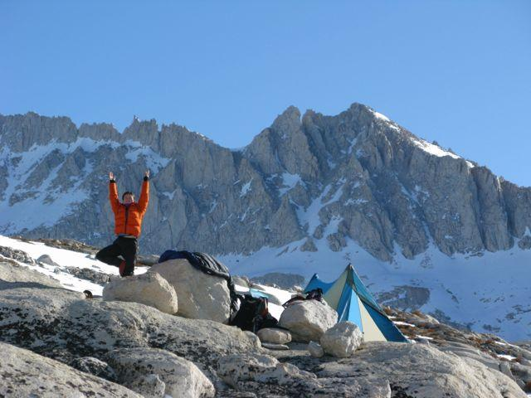
Snow camping

Slide 17
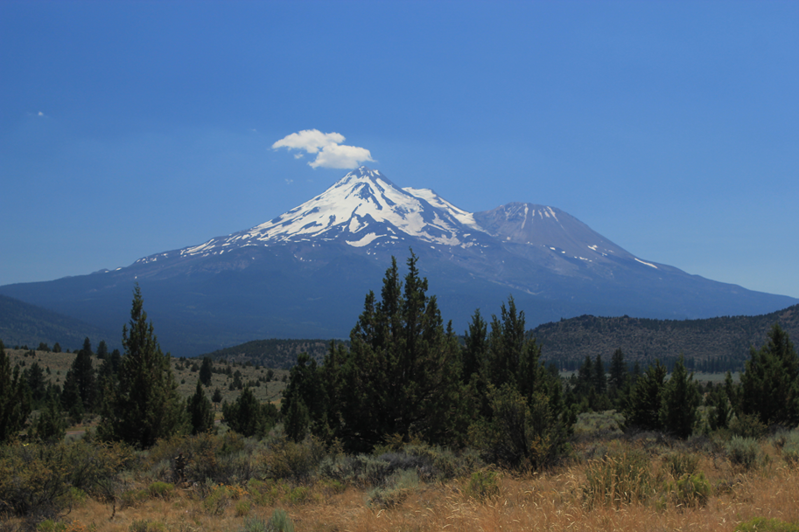
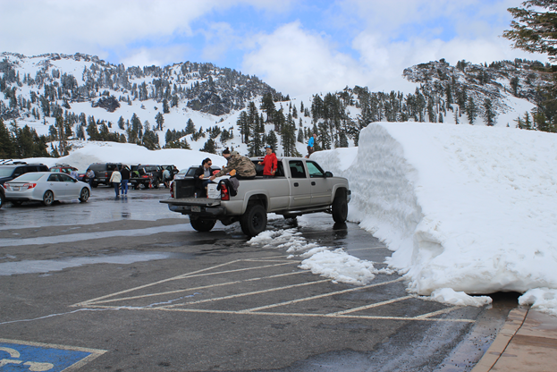
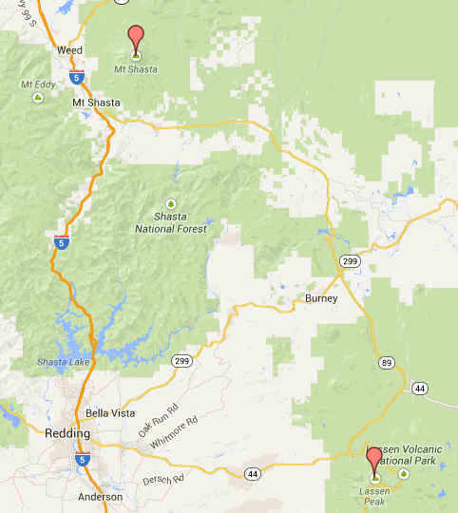
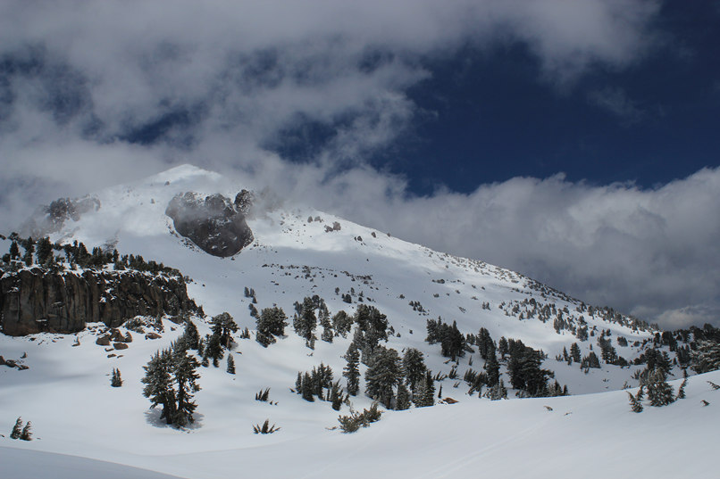
California’s northern
Volcanos
Mt. Shasta
14,179 ft
Lassen
10,463 ft

Slide 18
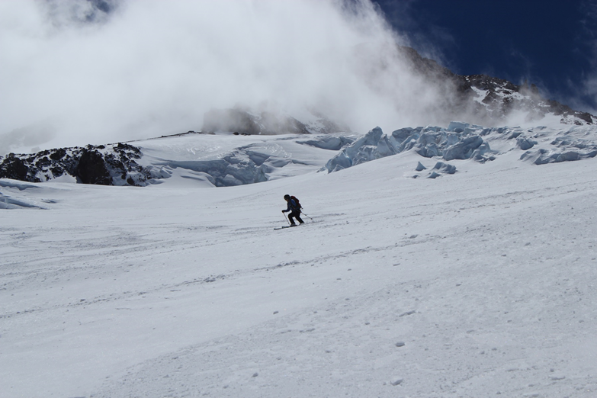
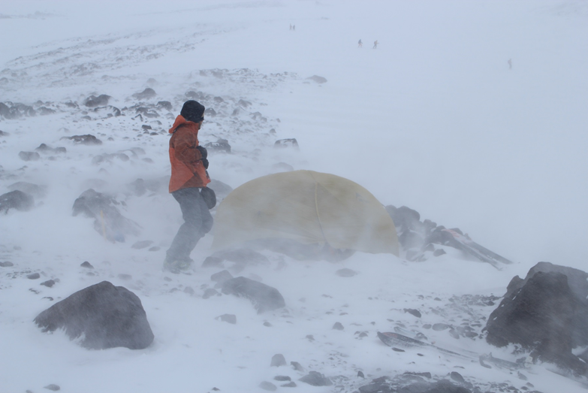
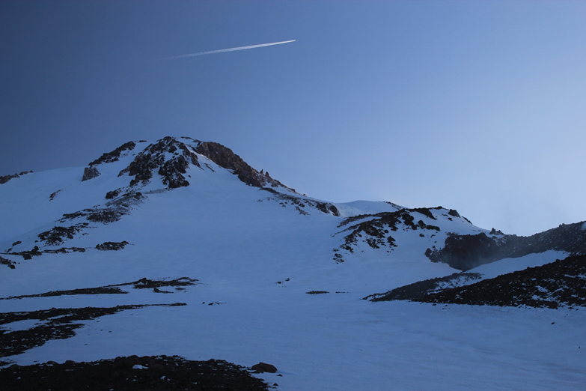
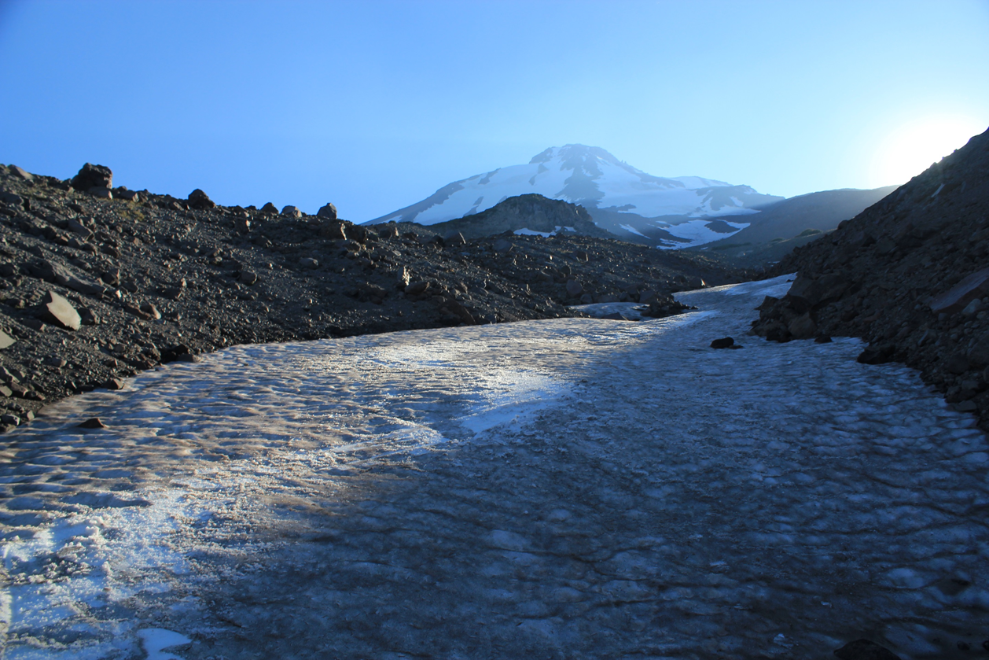
Mt. Shasta
Year-round skiing
opportunity - fun at
higher altitude

Slide 19
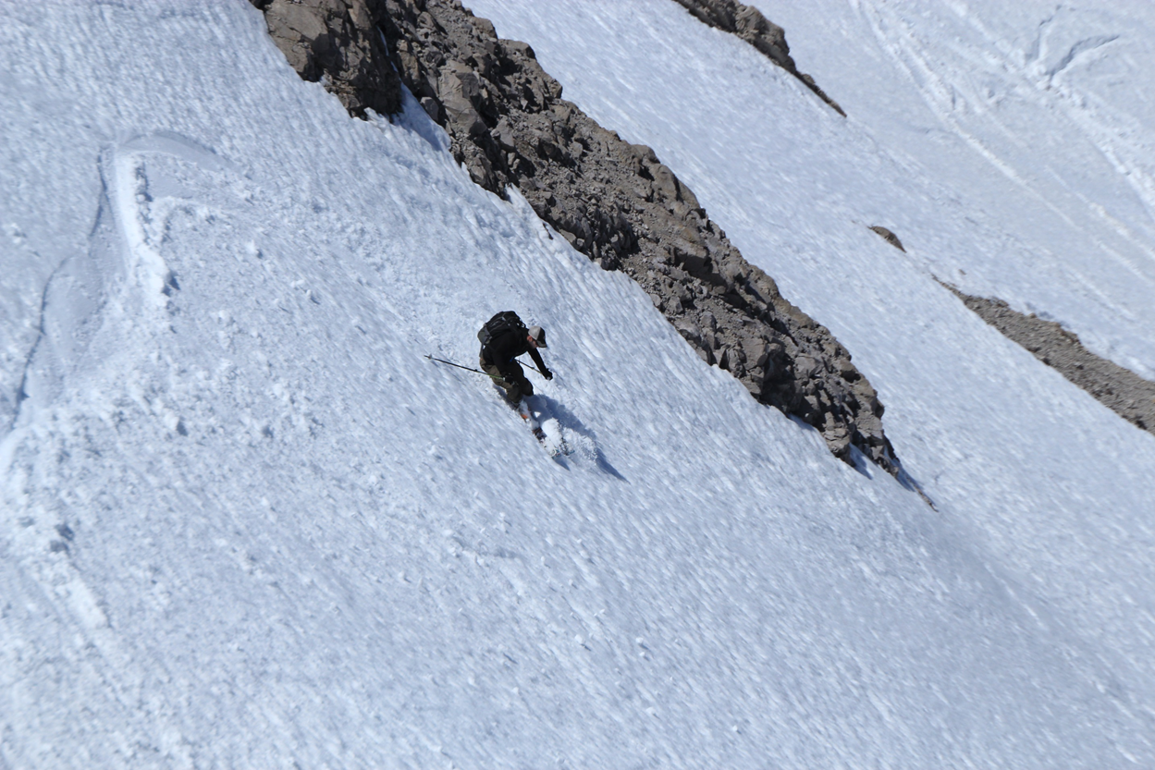
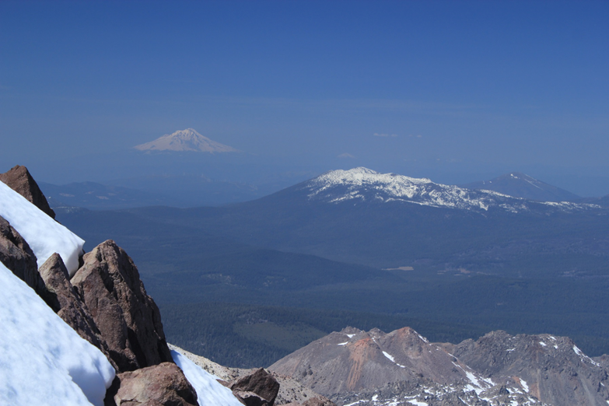
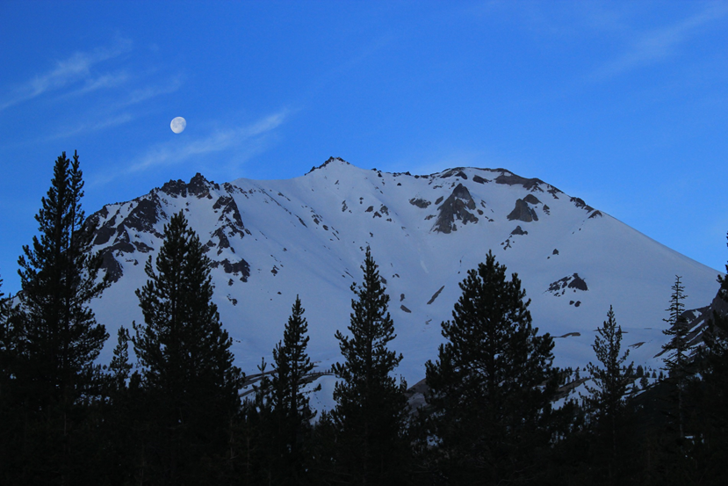
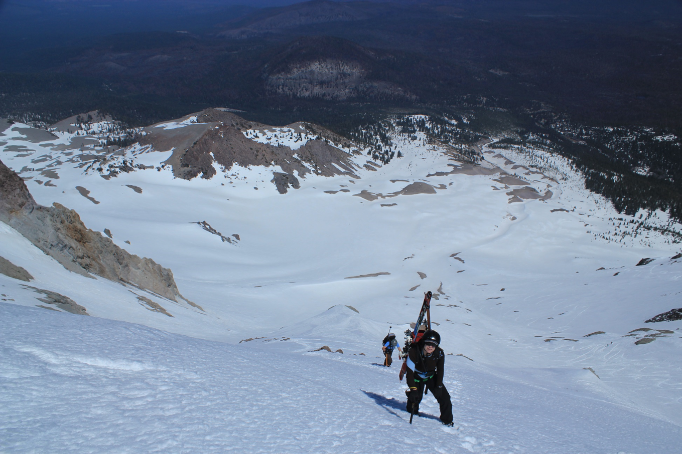
Lassen peak
Great skiing terrain
360deg descent possible
Easy access once road is cleared (May/June)

Slide 20
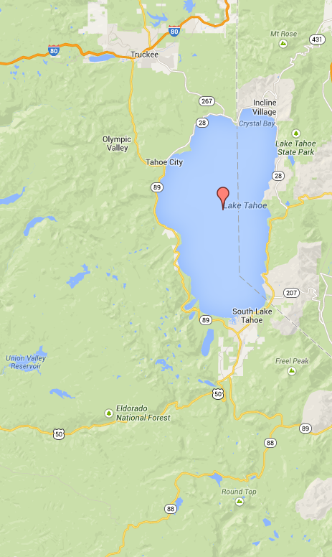
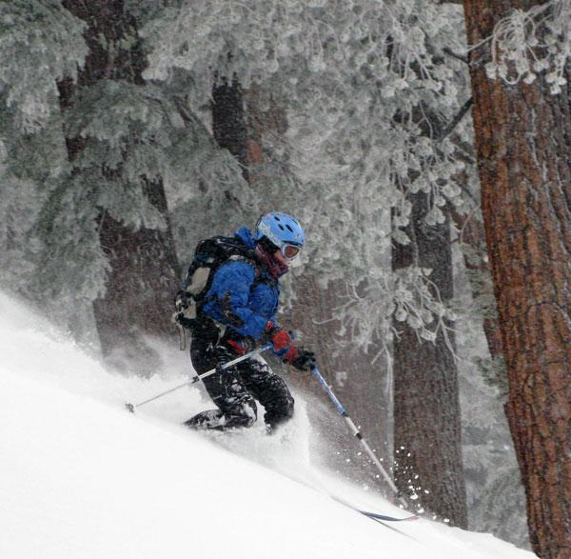
Tahoe area
Easy access, reliable snow, and many areas to ski
Donner Pass area (I-50)
Mt Rose Area (HW 431)
West shore of Lake Tahoe (CA89)
Desolation wilderness
Carson Pass (CA88)

Slide 21
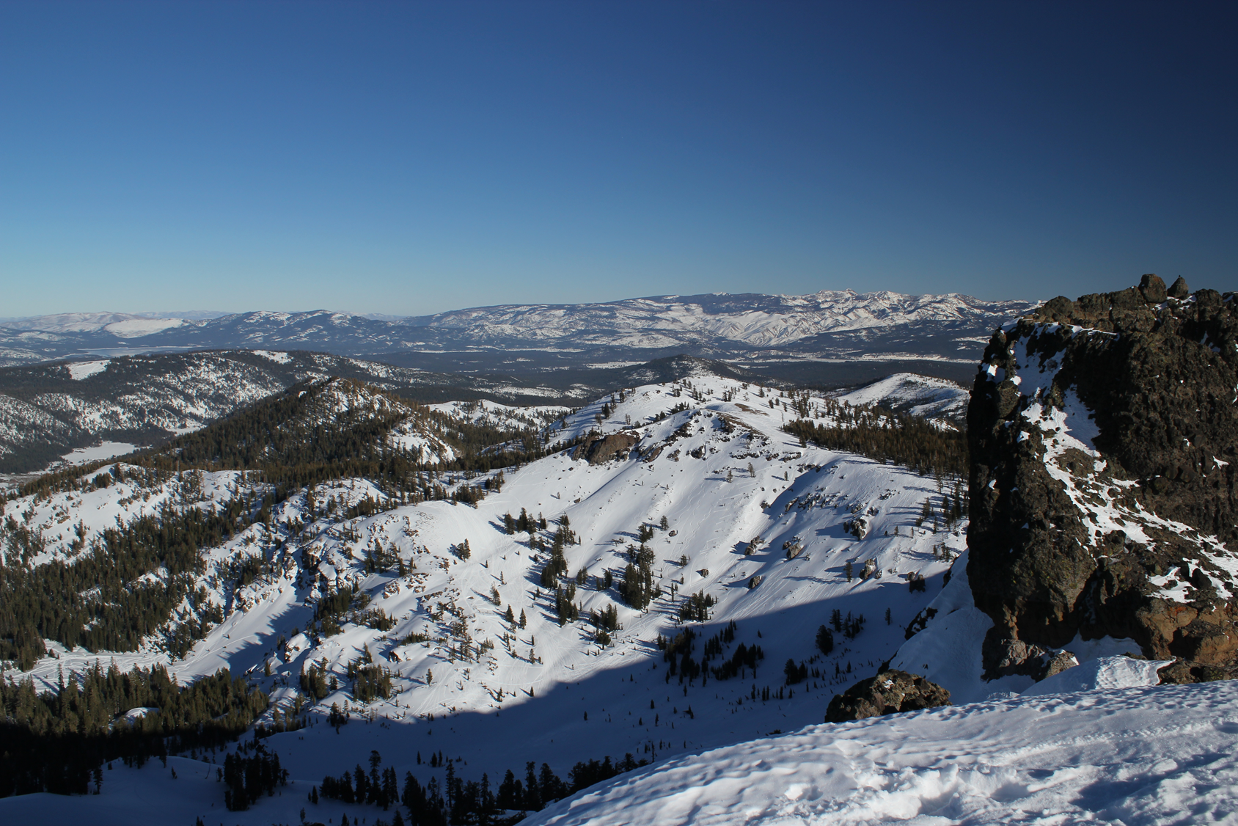
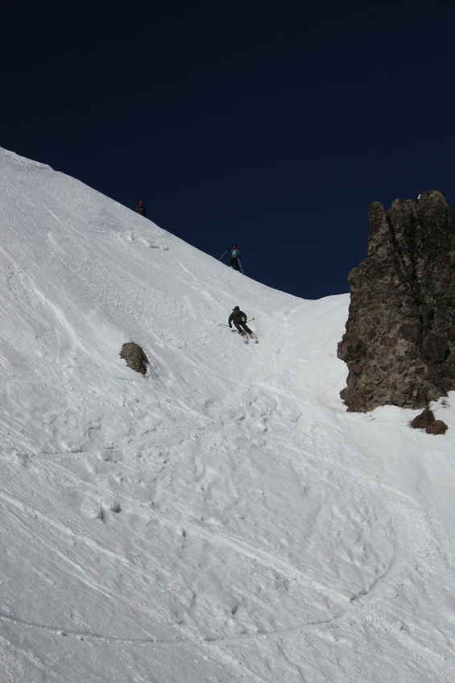
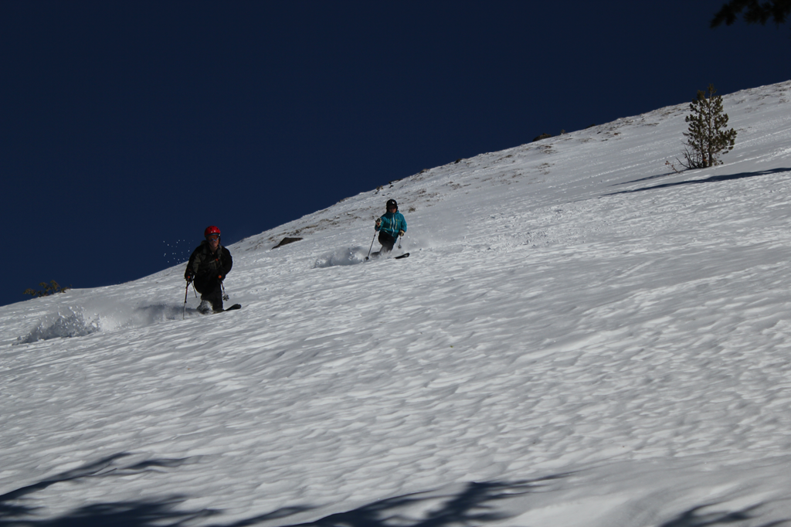
Donner pass
Skiing off Castle Peak
Castle Peak summit towards lake Tahoe

Slide 22
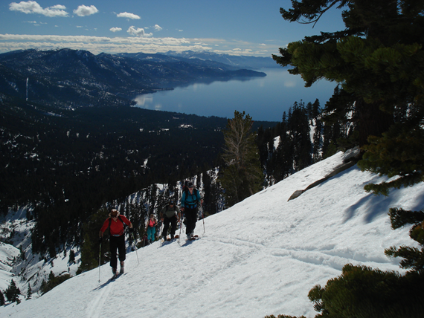
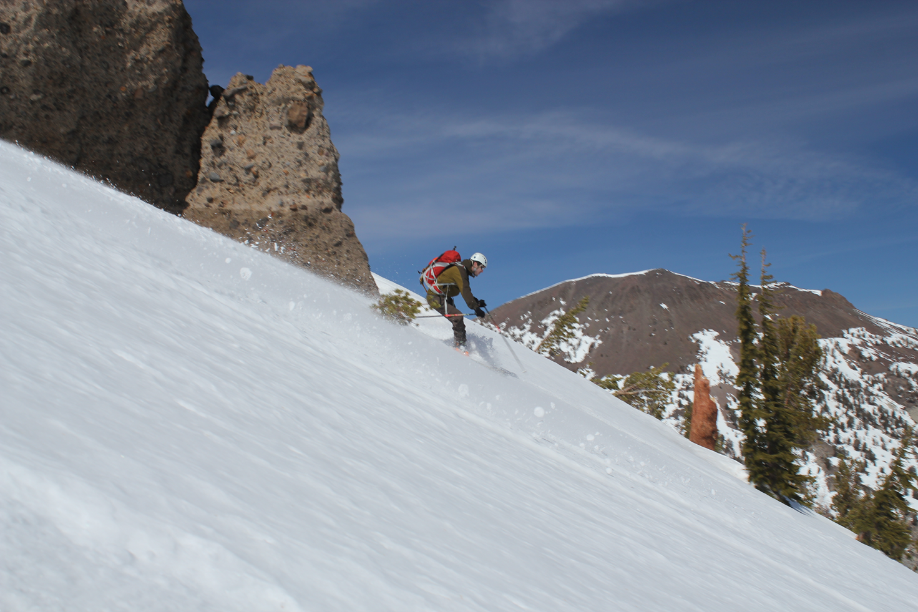
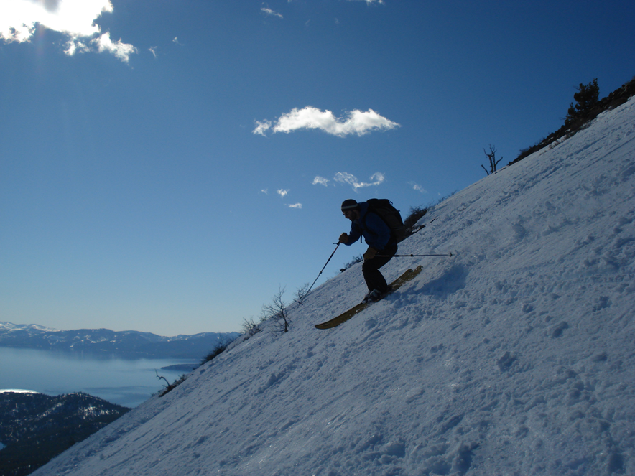
Mt. Rose area
Right:
Mt. Rose Knob Jr.
Bottom:
Skiing the hour glass on Tamarak

Slide 23
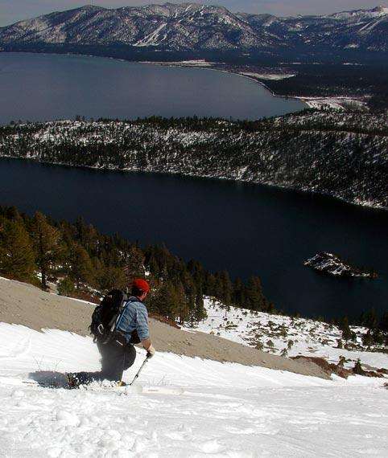
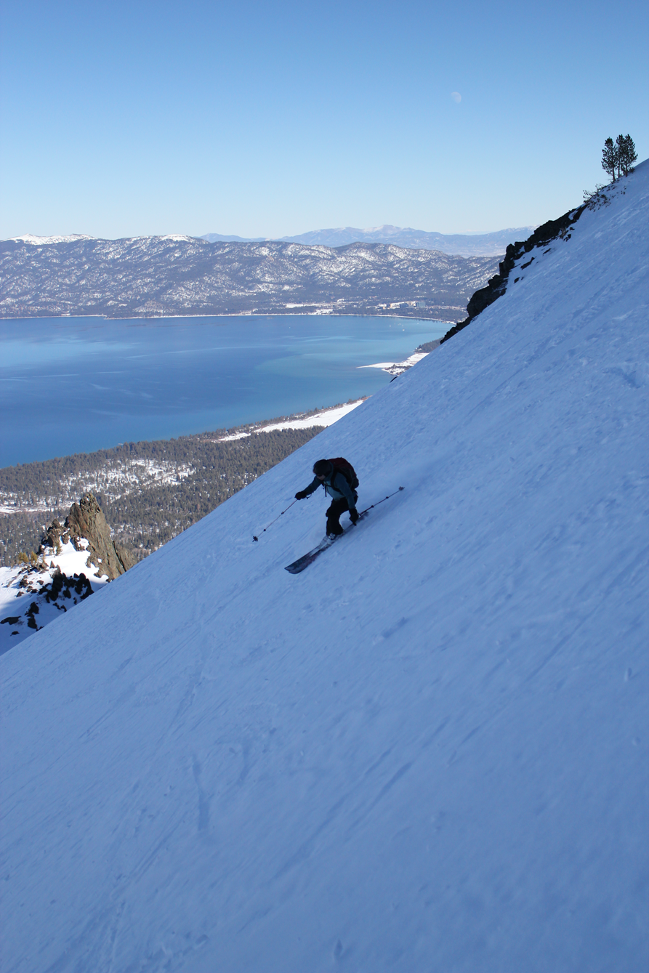
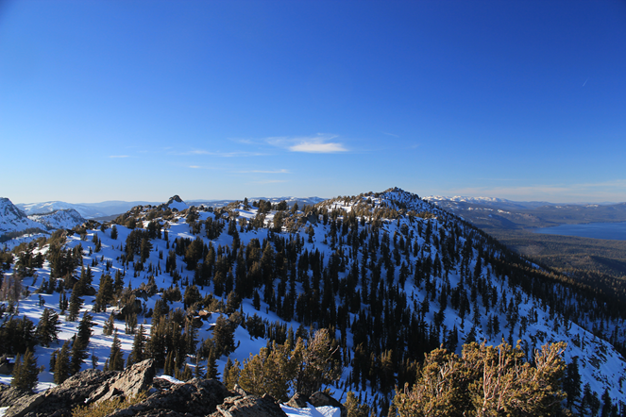
Tahoe area west rim
Bliss and Rubicon peak from Jake’s
South face of Jake’s
above Emerald bay
Skiing off Mt. Tallac

Slide 24
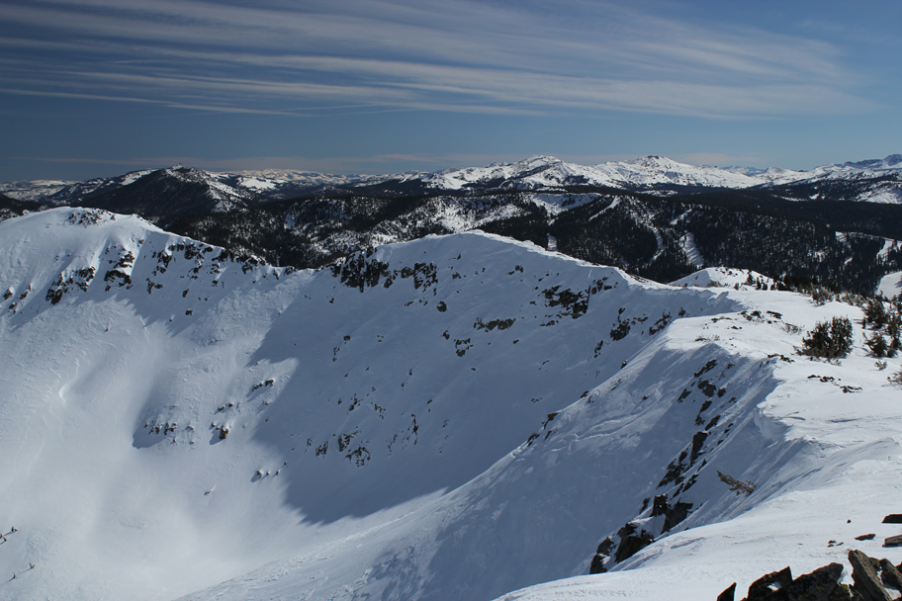
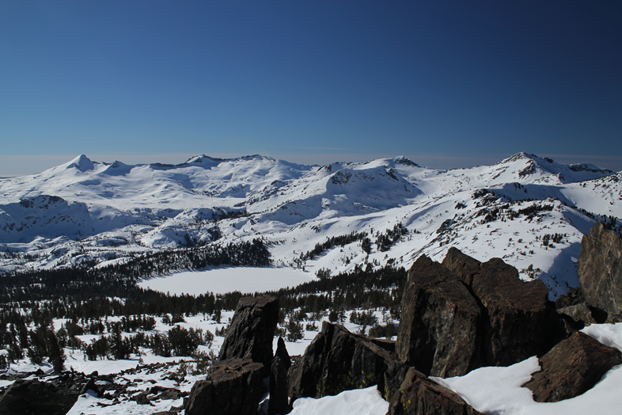

Desolation Wilderness
Left: Summit bowl of Ralston and view towards Mt. Tallac
Summit bowl on Ralston peak
Pyramid peak and Dick’s from Mt. Tallac

Slide 25


Tahoe area South / Carson pass
Carson pass has easy access, a high trailhead and reliable snow.
Above - skiers above Crater Lake
Right - skier above Red Lake

Slide 26



Carson Pass
Left - Skiing powder in Crater Lake bowl.
Right - Castle Peak and Crater Lake bowl.

Slide 27



Roundtop Mountain
10,381 ft
Crescent Moon Couloir

Slide 28


Sonora Pass
This pass allows easy spring-time access to the high country

Slide 29

Sonora Pass, Tioga Pass, Eastern Sierra
Sonora pass
Tioga pass
Mammoth

Slide 30


Tioga Pass
Beautiful views of Mono Lake
Difficult access when road is closed
Top: biking for some turns
Left: Mt. Dana summit

Slide 31


Tioga Pass
Big powder weekend, Gaylor peak, el 11,004 ft,January
Kidney Chute, south of Dana Plateau, May

Slide 32


Tioga pass
Car access in the winter is restricted! January powder

Slide 33


Mammoth backcountry
The Mammoth area has good access to great peaks and tours.
Left - skier descending Bloody Couloir.
Right - Ascent of Steelhead pass.

Slide 34


Mammoth backcountry
These photos are from a four day tour along the Sierra crest from Mammoth to Rock Creek.

Slide 35


Eastern Sierra
The east side of the Sierra is nirvana for backcountry skiers. Spring is the best time to visit. Warm temps, corn snow, big peaks, great views, hot springs are easy to find.
Above - Sawtooth range, Northern Yosemite, May.
Right - Skiers above Mono Lake.

Slide 36


Eastern Sierra
Above - sunset from Muir pass, JMT, May. Right- “Sierra Wave”, Palisades tour, May.

Slide 37

Eastern Sierra
Mammoth
Bishop
Palisades

Slide 38

Eastern Sierra - Palisades Tour

Slide 39


Palisades Tour
The Palisades are a favorite for climbers and features several peaks over 14, 000 ft. These photos are from a ski tour around the Palisades in May.

Slide 40


Ionian Basin and the John Muir Trail
A multi-day (5) tour into a remote area of the Sierra- Ionian basin, and a ski along the Muir Trail. Above - view from top of Black Giant, el 13,330 ft. Right - skier approaches the Muir Hut on the JMT, el 11, 800 ft.

Slide 41


Ionian Basin and the John Muir Trail
Below - Darwin Bench, the Hermit is the peak behind the skiers.
Right - Campsite on the Darwin Bench

Slide 42

Eastern Sierra
Kings Canyon
Mt Whitney
Sequoia

Slide 43


Mt Whitney (el 14, 494 ft)
Mt Whitney is the highest point in the lower 48 states and it is in California! These photos are from a five day tour around the peak.

Slide 44


Mt Whitney
Below - Russell Carillion pass, (el, 13,280 ft.) Right - ski descent from Trail Crest (el 13648 ft) down from Mt Whitney.

Slide 45
Where else to find information
Avalanche bulletin (incomplete)
http://www.shastaavalanche.org
http://www.esavalanche.org/
www.sierraavalanchecenter.org
Websites
Marcus Libkind (http://www.backcountryskitours.com)
The Backcountry (http://www.thebackcountry.net/)
Bob Akka’s webpage (http://bobskiing.com/)
Transportation
http://www.dot.ca.gov/
Local stores
Mammoth Mountaineering (Mammoth Lakes)
Wilson’s Eastside Sports (Bishop)
The Fifth Season (Shasta)
On-line forums
Earn your turns, Teton Gravity Research, Splitboard.com
Weather
www.opensnow.com
www.wundergrund.com
http://www.wrh.noaa.gov

Slide 46


Observations Sierra Avalanche Center

Slide 47

Thebackcountry.net - the bucket list

Slide 48



Paper information old school
50 Classic Backcountry Ski and Snowboard Summits in California: Mount Shasta to Mount Whitney - Paul Richins Jr.
Backcountry skiing California’s Eastern sierras - Dan Mingori & Nate Greenberg
California’s High Sierra -
Moynier, Herschalla

Slide 49


Get out and shred the gnar!

